Slide 1
Introduction to Azure SQL Database
Module 1

Slide 3
Learning Units covered in this Module
Lesson 1: Basic concepts of Azure SQL Database
Lesson 2: How to create Azure SQL Database
Lesson 3: Introduction to Elastic Database Pools in Azure SQL Database
Lesson 4: The difference between SQL Server IaaS and PaaS Solutions

Slide 4
Lesson 1: Basic concepts of Azure SQL Database

Slide 5

Objectives
After completing this learning, you will be able to:
Describe the basic concept and architecture
Describe the difference between the purchase models.
Describe the service tiers compute and hardware generation of the Azure SQL Database.

Slide 6
What is Microsoft Azure?
Microsoft Azure is Microsoft’s public cloud computing platform
Over 140 countries across 56 regions worldwide
Windows and Linux
Scale globally
Reach more locations, faster, with the performance and reliability of a vast global infrastructure.
Safeguard data
Rely on industry-leading data security in the region and across our network.
Promote sustainability
Help build a clean-energy future and accelerate progress toward your sustainability goals.
Notes:
https://azure.microsoft.com/en-us/global-infrastructure/regions/
Microsoft Azure is Microsoft's public cloud computing platform and infrastructure for building, deploying, and managing applications and services through a global network of Microsoft-managed datacenters. It provides both PaaS and IaaS services and supports many different programming languages, tools and frameworks, including both Microsoft-specific and third-party software and systems. It consists of over 140 countries across 56 regions worldwide with more being added all the time. It provides hyper scale computing capabilities and makes up the top 3 networks in the world.
Azure regions
Azure has more global regions than any other cloud provider—offering the scale needed to bring applications closer to users around the world, preserving data residency, and offering comprehensive compliance and resiliency options for customers.
Scale globally
Reach more locations, faster, with the performance and reliability of a vast global infrastructure.
Safeguard data
Rely on industry-leading data security in the region and across our network.
Promote sustainability
Help build a clean-energy future and accelerate progress toward your sustainability goals.

Slide 7
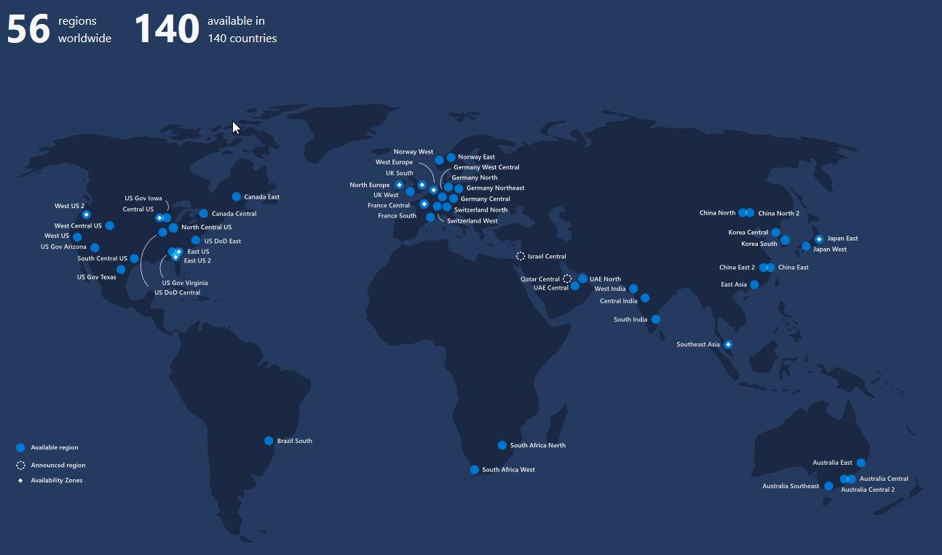
What is Microsoft Azure?
https://azure.microsoft.com/en-us/global-infrastructure/regions/
Notes:
https://azure.microsoft.com/en-us/global-infrastructure/regions/
Microsoft Azure is Microsoft's public cloud computing platform and infrastructure for building, deploying, and managing applications and services through a global network of Microsoft-managed datacenters. It provides both PaaS and IaaS services and supports many different programming languages, tools and frameworks, including both Microsoft-specific and third-party software and systems. It consists of over 140 countries across 56 regions worldwide with more being added all the time. It provides hyper scale computing capabilities and makes up the top 3 networks in the world.
Azure regions
Azure has more global regions than any other cloud provider—offering the scale needed to bring applications closer to users around the world, preserving data residency, and offering comprehensive compliance and resiliency options for customers.
Scale globally
Reach more locations, faster, with the performance and reliability of a vast global infrastructure.
Safeguard data
Rely on industry-leading data security in the region and across our network.
Promote sustainability
Help build a clean-energy future and accelerate progress toward your sustainability goals.

Slide 8
Benefits of Cloud Computing
On and Off
Inactivity
Period
On and off workloads (for example: batch job).
Over provisioned capacity is wasted.
Time to market can be cumbersome.
Compute
t
Growing Fast
Compute
Successful services needs to grow/scale.
Keeping up with growth is a big IT challenge.
Cannot provision hardware fast enough.
t
Unpredictable Bursting
Compute
Unexpected/unplanned peak in demand.
Sudden spike impacts performance.
Cannot over provision for extreme cases.
t
Predictable Bursting
Compute
Services with micro seasonality trends.
Peaks due to periodic increased demand.
IT complexity and wasted capacity.
t
Notes:
On and Off
On and off workloads (for example: batch job).
Over provisioned capacity is wasted.
Time to market can be cumbersome.
Growing Fast
Successful services needs to grow/scale.
Keeping up with growth is a big IT challenge.
Cannot provision hardware fast enough.
Unpredictable Bursting
Unexpected/unplanned peak in demand.
Sudden spike impacts performance.
Cannot over provision for extreme cases.
Predictable Bursting
Services with micro seasonality trends.
Peaks due to periodic increased demand.
IT complexity and wasted capacity.

Slide 9
Database as a Service
Hosting models
Business model
Infrastructure
(as a Service)
Platform
(as a Service)
Software
(as a Service)
On-Premises
Applications
You scale, make
resilient & manage
Applications
You manage
Applications
Applications
You scale, make resilient and manage
Scale, resilience and management by vendor
Data
Data
Data
Data
Runtime
Runtime
Runtime
Scale, resilience and management by vendor
Runtime
Middleware
Middleware
Middleware
Middleware
O/S
O/S
Managed by vendor
O/S
O/S
Virtualization
Virtualization
Virtualization
Virtualization
Servers
Servers
Servers
Servers
Storage
Storage
Storage
Storage
Networking
Networking
Networking
Networking
Notes:
After this section, the attendee should be able to explain differences between IaaS, PaaS, SaaS and position Azure SQL Database under Platform-as-a-Service (PaaS). Within PaaS, managed databases are sometimes referred to as Database-as-a-service (DBaaS).

Slide 10
Hosting Models
Managed by customer
Managed by Microsoft
On-premises
Infrastructure
(as a Service)
Platform
(as a Service)
On-premises costs tend to be driven by hardware and data center management costs
Infrastructure-as-a-Service reduces cost categories related to data center and compute
Platform-as-a-Service off-loads customers’ most administrative tasks to Azure, further improving efficiency with machine-learning capabilities for performance and security
Managed Instance: instance-level deployment for lift-shift existing apps to Azure, fully backward compatible
Single database: database-level deployment for new apps
Applications
Applications
Applications
Data
Data
Data
High availability /DR/Backups
High availability /DR/Backups
High Availability/ DR/Backups
Database Provision/ Patch/Scaling
Database Provision/ Patch/Scaling
Database Provision/ Patch/Scaling
O/S provision /patching
O/S
O/S
Virtualization
Virtualization
Virtualization
Hardware
Hardware
Hardware
Datacenter Management
Datacenter Management
Datacenter Management
SQL Server 2017/2019
Azure SQL VMs
Azure SQL Database
Notes:
Azure SQL Database is a fully-managed platform-as-a-service. This means Microsoft operates SQL Server for you, assuming much of the daily maintenance, administration and infrastructure costs of your IT organization.
Quickly realize spend and operational efficiencies you may not have otherwise experienced with your on-premises or hosted solution.
Along with ensured availability and performance, features of Azure SQL Database include:
Provisioning and resizing (w/ Azure Portal experience)
Built-in auto HA (99.99%)
Automatic backup
Point-in-time-restore (database-level)
Active geo-replication
Intelligent performance optimization and security of your databases

Slide 11
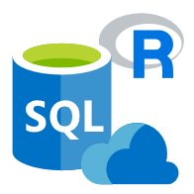
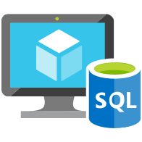


Data platform continuum
PaaS
Azure SQL Database
Virtualized Database
Shared lower cost
IaaS
SQL Server in Azure VM
Virtualized Machines
Virtual
SQL Server Private Cloud
Virtualized Machine + Appliance
Physical
SQL Server
Physical Machine (raw iron)
Dedicated higher cost
Higher administration
Lower administration
Notes:
Objective: One of the first things to understand in any discussion of Azure versus on-premises SQL Server databases is that you can use it all. The Microsoft data platform leverages SQL Server technology and makes it available across physical on-premises machines, private cloud environments, third-party hosted private cloud environments, and public cloud. This enables you to meet unique and diverse business needs through a combination of on-premises and cloud-hosted deployments, while using the same set of server products, development tools, and expertise across these environments.
Talking Points:
As seen in the diagram, each offering can be characterized by the level of administration you have over the infrastructure (on the X axis), and by the degree of cost efficiency achieved by database level consolidation and automation (on the Y axis).
When designing an application, four basic options are available for hosting the SQL Server part of the application:
SQL Server on nonvirtualized physical machines
SQL Server in on-premises virtualized machines (private cloud)
SQL Server in Azure Virtual Machine (public cloud)
Azure SQL Database (public cloud)

Slide 12
Azure SQL has come a long way
2006
2010
2013
2015
2018
2020
CloudDB
RedDog
Windows Azure and SQL Azure launch
Azure
Virtual Machines
Azure SQL Database V12
Azure SQL Database Managed Instance
Azure SQL Family
Windows Azure and SQL Data Services announced
SQL Azure →
Azure SQL Database
Windows Azure → Microsoft Azure
Azure SQL Database Elastic Pools
Azure SQL Database Hyperscale
Azure SQL Database Serverless
Azure SQL Instance Pools
2008
2012
2014
2016
2019
Notes:
Azure SQL has evolved over the years to include Virtual Machine, Managed Instances, and several options for Databases. There are now multiple deployment options with the flexibility to scale to your needs, and there have been over seven million deployments of some form of Azure SQL. The architecture for Azure SQL has also evolved to meet the ever growing demands of applications. E.g. elastic databases, vCore choices, Business Critical deployments, Hyperscale, and Serverless architectures.
Since 2008, SQL Server has changed a lot and Azure SQL has changed a lot. It's no surprise then that the role of the SQL Server professional has also changed a lot and today I want to help you become an Azure SQL professional.
2006
CloudDB Project
RedDog Project
2008
Windows Azure and SQL Data Services announced at PDC
2010
Windows Azure and SQL Azure officially launch.
2012
SQL Azure branded Azure SQL Database
2013
Azure Virtual Machines released
2014
Windows Azure branded Microsoft Azure
2015
Azure SQL Database V12 released
2016
Azure SQL Database Elastic Pools released
2018
Azure SQL Database Managed Instance released
2019
Azure SQL Database Hyperscale Released
Azure SQL Database Serverless Released

Slide 13
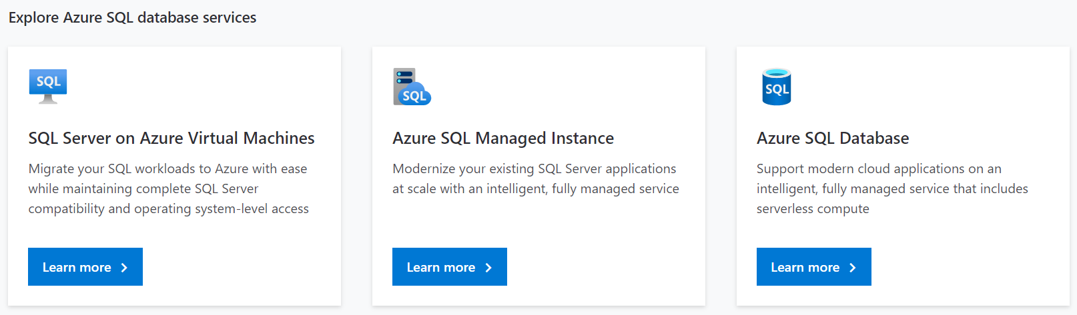
Azure SQL Family

Slide 14
Azure SQL Database Architecture
Client Layer
Used by the application to communicate directly with Azure SQL Database.
Services Layer
Gateway between Client Layer and Platform Layer.
Platform Layer
Includes physical servers and services that support the Services Layer.
Infrastructure Layer
IT administration of the physical hardware and operating system.
Client Layer
PHP
SQL Server
Applications and Tools
WCF Data Services
ODBC/JDBC
ADO.NET
Tabular Data Stream (TDS)
TDS+SSL
Services Layer
Provisioning
Provisioning
Provisioning
…
Billing and Metering
Billing and Metering
Billing and Metering
…
Connection Routing
Connection Routing
Connection Routing
…
Platform Layer
SQL Server
SQL Server
SQL Server
…
SQL Database Fabric
SQL Database Fabric
SQL Database Fabric
…
Management Services
Management Services
Management Services
…
Infrastructure Layer
Notes:
The objective of this part of the lesson is to explain the architecture of Azure SQL Database. There are four layers: Client, Services, Platform and Infrastructure.
The Client layer is the same as any client communication to Microsoft SQL Server because Azure SQL Database uses the same transport protocol as other versions of SQL Server, namely, TDS (Tabular Data Stream). This means you can use all the normal client tools such as SQL Server Management Studio (SSMS), SQLCMD and client libraries such as ADO.NET, ODBC and JDBC with standard connection strings.
The Services layer acts as a gateway between the Client and Platform layers and provides provisioning, billing and routing functionality.
The Platform layer includes the physical servers and the database fabric.
The Infrastructure layer includes administration of the physical hardware and the operating system.

Slide 15



What are my options?
SQL
IaaS
PaaS
I want a Virtual Machine
I want a SQL Server
Azure manages the hardware
You own monitoring and HADR
I want a database
Azure manages the hardware, OS, and SQL Server
Azure provides HADR, monitoring, and intelligence
Azure gives you predicable performance
You own the OS and SQL Server
Azure manages the hardware and OS
You get a SQL Server, but we help you manage it
You need SQL Server feature compatibility and low friction move
SQL Server in
Azure Virtual Machine
Managed Instance
Azure SQL Database
Single Instance Pool
Single Elastic Pool
Notes:
SQL virtual machine
Best for migrations and applications requiring OS-level access.
Managed instances
Best for most lift-and-shift migrations to the cloud.
SQL Database
Best for modern cloud applications. Hyperscale and serverless options are available.

Slide 16
A closer look… Best for
SQL Server in Azure VM
New applications or existing on-premises applications that want to use the latest stable SQL Server features and that are migrated to the cloud with minimal changes.
Teams that need built-in high availability, disaster recovery, and upgrade for the database.
Teams that do not want to manage the underlying operating system and configuration settings.
Databases of up to 8 TB, or larger databases that can be horizontally or vertically partitioned using a scale-out pattern.
New cloud-designed applications that want to use the latest stable SQL Server features and have time constraints in development and marketing.
Teams that need built-in high availability, disaster recovery, and upgrade for the database.
Teams that do not want to manage the underlying operating system and configuration settings.
Databases of up to 4 TB, or larger databases that can be horizontally or vertically partitioned using a scale-out pattern.
Azure SQL Datababase
Existing applications that require fast migration to the cloud with minimal changes or no changes.
Teams that can configure, fine tune, customize, and manage high availability, disaster recovery, and patching for SQL Server.
You need a customized environment with full administrative rights.
SQL Server instances with up to 64 TB of storage. The instance can support as many databases as needed.
Managed Instance
Notes:
Listed are the most common motivations to choose an Azure SQL Database or SQL Server running on an Azure VM or a Managed Instance as a hybrid solution.

Slide 17



Azure SQL PaaS deployment options
SQL
Azure SQL Database
Managed instances
Databases
Best for most lift-and-shift migrations to the cloud
Best for modern cloud applications. Hyperscale and serverless options are available
Single instance
Instance pool*
Single database
Elastic pool
SQL Server surface area (vast majority).
Native virtual network support.
Fully managed service.
Resource sharing between multiple instances to price optimize.
Simplified performance management for multiple databases.
Fully managed service.
Hyperscale storage (up to 100TB).
Serverless compute.
Fully managed service.
Resource sharing between multiple databases to price optimize.
Simplified performance management for multiple databases.
Fully managed service.
*Instance pool is currently in public preview, more details here
Notes:
Azure SQL Database has 4 deployment options: Managed Instance, single instance and instance pool and SQL Database, single database and elastic pool.
Managed Instance:
Single: Instance-scoped deployment option with high compatibility with SQL Server and full PaaS benefits.
Instance Pool: Are a new resource in Azure SQL Database that provides a convenient and cost-efficient way to migrate smaller SQL instances to the cloud at scale. It enables the deployment of multiple instances on the same virtual machine where the virtual machine's compute size is based on the total number of vCores allocated for the pool.
Azure SQL Database:
Single: Each standalone database is assigned a certain amount of resources via performance tiers: Basic, Standard, and Premium. The emphasis of this offering focuses on a simplified database-scoped programming model and applications with a predictable pattern and relatively stable workload.
Elastic Pool: An elastic database pool is a shared resource model that enables higher resource utilization efficiency, and all the databases within an elastic pool share predefined resources within the same pool. The emphasis of this offering is on a simplified database-scoped programming model for multi-tenant SaaS apps. The workload pattern is well-defined and is highly cost-effective in multi-tenant scenarios. For ISVs with SaaS apps, the savings can be significant, in the hundreds of thousands of dollars or more.

Slide 18
Azure SQL Database Purchasing models and resources
Database Transaction Unit (DTU) model
Pre-packaged, bundled unit that represents the database power.
vCore model
À La carte approach deconstructs the DTU model into separate parts.
Customers can select compute and storage independently.
Allows customers to right-size their compute requirements in the cloud.
vCore sizing offers flexibility of choice.
Provides a choice between a provisioned compute tier and a serverless compute tier.
Designed for predictable performance, but somewhat inflexible and limited in options.
DTU sizing offers simplicity of choice.
Blended measure of CPU, memory, and read-write rates.
DTU model
Fixed scalability
Compute
Storage
New vCore model
Independent scalability
Compute
Storage
Notes:
DTU-based model:
This model is based on a bundled measure of compute, storage, and IO resources. Performance levels are expressed in terms of Database Transaction Units (DTUs) for single databases and elastic Database Transaction Units (eDTUs) for elastic pools. Best for customers who want simple, pre-configured resource options.
vCore-based model:
This model allows you to independently scale compute and storage resources. It also allows you to use Azure Hybrid Benefit for SQL Server to gain cost savings. Best for customers who value flexibility, control, and transparency.
In the vCore-based purchasing model, you pay for:
Compute resources (the service tier + the number of vCores and the amount of memory + the generation of hardware).
The type and amount of data and log storage.
Backup storage (RA-GRS).

Slide 19
Purchasing models available for Azure SQL Database deployment:
Purchasing model/ Deployment model | DTU based | vCore based
Single Database
Elastic Pool
Managed Instance
Hyperscale service tier (single databases)
Notes:
Different purchasing models are available for different Azure SQL Database deployment models:
The single database and elastic pool deployment options in Azure SQL Database offer both the DTU-based purchasing model and the vCore-based purchasing model.
The managed instance deployment option in Azure SQL Database offers only the vCore-based purchasing model.
The hyperscale service tier is available for single databases that are using the vCore-based purchasing model.

Slide 20
Overview Service Tiers
DTU based
Basic
Standard
Premium
vCore based
General purpose.
Business critical
Hyperscale
Standard 100DTUs = 1vCore
Premium 125DTUs = 1vCore
Notes:
In the DTU-based purchasing model, you can choose between the basic, standard, and premium service tiers for both single databases and elastic pools. The DTU-based purchasing model isn't available for managed instances.
In the vCore-based purchasing model, you can choose between the general purpose and business critical service tiers for single databases, elastic pools, and managed instances. For single databases, you can also choose the hyperscale service tier.
Note: Serverless is not a Service Tier is a compute type available in the General Purpose Service Tier.
* Fsv2-series and M-series are GA but available in specific regions
https://docs.microsoft.com/en-us/azure/azure-sql/database/service-tiers-vcore?tabs=azure-portal#hardware-generations

Slide 21
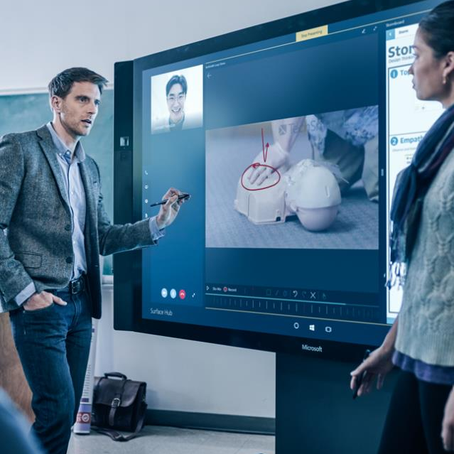
Demonstration
Overview of Service Tiers available for Azure SQL Database
Review the different Service Tiers, Compute and Hardware options available while creating an Azure SQL Database.
Notes:
M01L01Demo01
Demo setup instructions
Open the latest version of the SQL Server Management Studio
Steps
Connect to the Azure Portal, click on “Create a resource” and search for “SQL Database”
Choose SQL Database > Create
Skip all other options and go to Compute + storage
Explain the different options, Service Tiers, Hardware Generations and available Compute alternatives.
Note: The creation of the database will be done in another demonstration. The purpose of this exercise is to discuss the Service Tiers, Hardware Generations and available Compute alternatives available.

Slide 22
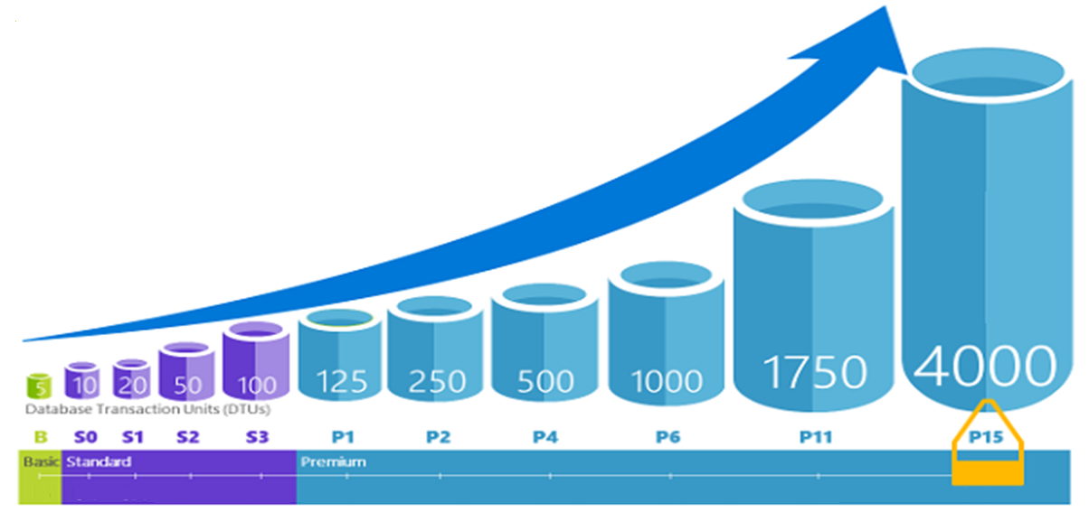
Database Transaction Units (DTUs)
Notes:
For a single Azure SQL database at a specific performance level within a service tier, Microsoft guarantees a certain level of resources for that database (independent of any other database in the Azure cloud) and providing a predictable level of performance. This amount of resources is calculated as a number of Database Transaction Units or DTUs, and is a blended measure of CPU, memory, I/O (data and transaction log I/O). Doubling the DTUs by increasing the performance level of a database is the same as doubling the set of resource available to that database. For example, a Premium P11 database with 1750 DTUs provides 350x more DTU compute power than a Basic database with 5 DTUs.
How can I determine the number of DTUs needed by my workload?
If you are looking to migrate an existing on-premises or SQL Server virtual machine workload to Azure SQL Database, you can use the DTU Calculator to approximate the number of DTUs needed.

Slide 23
DTU-based model: Service Tiers
 | Basic | Standard |  |  |  |  |  |  |  |  | Premium
 |  | S0 | S1 | S2 | S3 | S4 | S6 | S7 | S9 | S12 | P1 | P2 | P4 | P6 | P11 | P15
Built for | Light transactional workloads | Medium transactional workloads |  |  |  |  |  |  |  |  | Heavy transactional workloads
Available SLA | 99.99%
Database max. size | 2 GB | 250 GB |  |  | 1 TB |  |  |  |  |  |  |  |  |  | 4 TB
Point-in-time restore (“oops” recovery) | Any point within 7 days | 7-35 days (7 days by default)
Business continuity | Active geo-replication, up to four readable secondary backups
Security | Auditing, row-level security, dynamic data masking, Advanced Threat Protection
Performance objectives | Transactions per hour | Transactions per minute |  |  |  |  |  |  |  |  | Transactions per second
Database transaction units (DTUs) | 5 | 10 | 20 | 50 | 100 | 200 | 400 | 800 | 1,600 | 3,000 | 125 | 250 | 500 | 1,000 | 1,750 | 4,000
$
Resource limits for single databases using the DTU-based purchasing model
$$$
Notes:
All three service tiers have an uptime SLA of 99.99%
Basic:
Basic tier is designed for applications with a light transactional workload. A typical use case is a lightweight application that needs a small database with a single operation at any given point in time.
Standard:
Standard tier is the go-to option for getting started with transactional workloads. It offers better performance and better built-in business continuity features compared to Basic tier. A typical use case is an application with multiple concurrent transactions.
Premium:
Premium tier is designed for mission-critical applications. It offers the best level of performance and access to advanced business continuity features including active geo-replication in up to 4 Azure regions of your choice. A typical use case is a mission-critical application with high transactional volume and many concurrent users.
https://docs.microsoft.com/en-gb/azure/azure-sql/database/service-tiers-dtu#compare-the-dtu-based-service-tiers

Slide 24
vCore-based purchasing model: Provisioned compute tier
Simplicity:
We remain committed to the DTU-based model and the simplicity it offers customers who want a pre-configured solution.
Flexibility:
The vCore-based model reflects our commitment to customer choice and to simplify the hybrid benefit for customers migrating from on-premises.
Customers pay for:
Service tier + number of vCores.
Type and amount of data storage.
Number of IO.
Backup storage (RA-GRS).
Notes:
vCore-based purchasing model: General purpose, hyperscale, and business critical
These service tiers are differentiated by a range of compute sizes, high-availability designs, fault-isolation methods, types and sizes of storage, and I/O
https://docs.microsoft.com/en-us/azure/sql-database/sql-database-service-tiers-vcore
https://azure.microsoft.com/en-us/pricing/details/sql-database/
vCore model so we can get AHB: 1 Enterprise license core = 1 Business Critical core
Business critical because online gaming wants the highest performance and HA
Gen 5 so we can scale our compute more
Also for read-scale replica, zone redundant HA
Zone Redundant Storage (ZRS) replicates your data synchronously across three storage clusters in a single region. Each storage cluster is physically separated from the others and is located in its own availability zone (AZ). Each availability zone—and the ZRS cluster within it—is autonomous and includes separate utilities and networking features. A write request to a ZRS storage account returns successfully only after the data is written to all replicas across the three clusters.
When you store your data in a storage account using ZRS replication, you can continue to access and manage your data if an availability zone becomes unavailable. ZRS provides excellent performance and low latency. ZRS offers the same scalability targets as locally redundant storage (LRS).

Slide 25
vCore-based purchasing model: Provisioned compute tier
Service tier | General purpose |  | Business critical |  | Hyperscale
Best for | Most budget-oriented workloads |  | Critical business applications with high IO requirements. |  | VLDB OLTP and HTAP workloads with highly scalable storage and read-scale requirements.
Deployment option | Single / Elastic Pools | Managed Instance | Single / Elastic Pools | Managed Instance | Single
Compute tiers | Gen5: 2 to 80 vCore Fsv2-series*: 72 vCore Serverless: 0.5 to 16 vCore | Gen5: 4 to 80 vCore | Gen5: 2 to 80 vCore M-series*: 128 vCore | Gen5: 4 to 80 vCore | Gen5: 2 to 80 vCore
Storage | Premium remote |  | Local SSD |  | Local SSD Cache
 | 5GB – 4TB per instance | 32GB – 8TB per instance | 5GB – 4TB per instance | 32GB – 4TB per instance | Scale from 5GB to 100TB of storage in 1GB increments
In-Memory | Not supported |  | Supported |  | Not supported
Read-write IO | ~2ms for all data access |  | <0.5ms for all data access |  | <0.5ms for hot data access ~2ms otherwise
Availability | 1 replica, no read-scale replicas |  | 3 read replicas, zone-redundant HA | 3 replicas, 1 read-scale replica, zone-redundant HA | Primary read/write replica + up to 4 read replicas
Backups | RA-GRS, 7-35 days (7 days by default) |  | RA-GRS, 7-35 days (7 days by default) |  | LRS, ZRS, RA-GRS, 7-35 days (7 days by default)
For latest information reference: https://azure.microsoft.com/en-us/pricing/details/sql-database/
* Fsv2-series and M-series are currently in preview.
Notes:
vCore-based purchasing model: General purpose, hyperscale, and business critical
These service tiers are differentiated by a range of compute sizes, high-availability designs, fault-isolation methods, types and sizes of storage, and I/O
https://docs.microsoft.com/en-us/azure/sql-database/sql-database-service-tiers-vcore
https://azure.microsoft.com/en-us/pricing/details/sql-database/
vCore model so we can get AHB: 1 Enterprise license core = 1 Business Critical core
Business critical because online gaming wants the highest performance and HA
Gen 5 so we can scale our compute more
Also for read-scale replica, zone redundant HA
Zone Redundant Storage (ZRS) replicates your data synchronously across three storage clusters in a single region. Each storage cluster is physically separated from the others and is located in its own availability zone (AZ). Each availability zone—and the ZRS cluster within it—is autonomous and includes separate utilities and networking features. A write request to a ZRS storage account returns successfully only after the data is written to all replicas across the three clusters.
When you store your data in a storage account using ZRS replication, you can continue to access and manage your data if an availability zone becomes unavailable. ZRS provides excellent performance and low latency. ZRS offers the same scalability targets as locally redundant storage (LRS).

Slide 26
General Purpose
Feature | Description
Number of vCores | 8, 16, 24 (Gen 4) 8, 16, 24, 32, 40, 64, 80 (Gen 5) 72 (Fsv2-series)
SQL Server version / build | SQL Server (latest available)
Min storage size | 32 GB
Max storage size | 8 TB
Max storage per database | Determined by the max storage size per instance
Expected storage IOPS | 500-7500 IOPS per data file (depends on data file). See Premium Storage
Number of data files (ROWS) per the database | Multiple
Number of log files (LOG) per database | 1
Managed automated backups | Yes
HA | Based on remote storage and Azure Service Fabric
Built-in instance and database monitoring and metrics | Yes
Automatic software patching | Yes
VNet - Azure Resource Manager deployment | Yes
VNet - Classic deployment model | No
Portal support | Yes
Redundant nodes
Azure storage accounts
Active compute nodes
Notes:
The architectural model for the general-purpose service tier is based on a separation of compute and storage. This architectural model relies on high availability and reliability of Azure Blob storage that transparently replicates database files and guarantees no data loss if underlying infrastructure failure happens.

Slide 27
Business Critical
Feature | Description
Number of vCores | 8, 16, 24, 32 (Gen 4) 8, 16, 24, 32, 40, 64, 80 (Gen 5) 128 (M-series)
SQL Server version / build | SQL Server (latest available)
Additional features | In-Memory OLTP 1 additional read-only replica (Read Scale-Out)
Min storage size | 32 GB
Max storage size | Gen 4: 1 TB (all vCore sizes Gen 5:1 TB for 8, 16 vCores 2 TB for 24 vCores 4 TB for 32, 40, 64, 80 vCores
Max storage per database | Determined by the max storage size per instance
Number of data files (ROWS) per the database | Multiple
Number of log files (LOG) per database | 1
Managed automated backups | Yes
HA | Based on Always On Availability Groups and Azure Service Fabric
Built-in instance and database monitoring and metrics | Yes
Automatic software patching | Yes
VNet - Azure Resource Manager deployment | Yes
VNet - Classic deployment model | No
Portal support | Yes
Primary endpoint
(read-write)
Read-only endpoint
Always On AG
SQL
Super-fast SSD
SQL
Primary replica
Secondary replica
SQL
SQL
Secondary replica
Secondary replica
Business Critical service tier: collocated compute and storage
Notes:
Business Critical service tier model is based on a cluster of database engine processes. This architectural model relies on a fact that there is always a quorum of available database engine nodes and has minimal performance impact on your workload even during maintenance activities.
Azure upgrades and patches underlying operating system, drivers, and SQL Server Database Engine transparently with the minimal down-time for end users.
Premium availability is enabled in Business Critical service tier of Azure SQL Database and it is designed for intensive workloads that cannot tolerate any performance impact due to the ongoing maintenance operations.
In the premium model, Azure SQL database integrates compute and storage on the single node. High availability in this architectural model is achieved by replication of compute (SQL Server Database Engine process) and storage (locally attached SSD) deployed in four node cluster, using technology similar to SQL Server Always On Availability Groups.

Slide 28
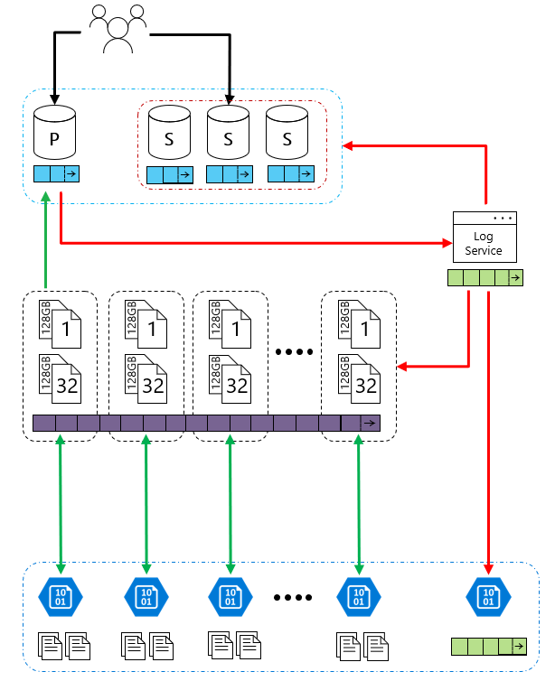
Hyperscale
Feature | Description
Number of vCores | Gen4: 1 to 24 vCore Gen5: 2 to 80 vCore
SQL Server version/build | SQL Server (latest available)
Additional features | 4 read-scale replicas 100TB Data Support Constant Time Operations
Min storage size | 4 GB
Max storage size | 100TB Grows as customer data grows
Max storage per database | Determined by the max storage size per instance
Number of data files (ROWS) per the database | Multiple
Number of log files (LOG) per database | 1
Managed automated backups | Yes
HA | High Availability is ensured on the storage layer
Built-in instance and database monitoring and metrics | Yes
Automatic software patching | Yes
VNet - Azure Resource Manager deployment | Yes
VNet - Classic deployment model | No
Portal support | Yes
Hyperscale Service Tier – Availability of Storage
Notes:
The Hyperscale service tier in Azure SQL Database is the newest service tier in the vCore-based purchasing model. This service tier is a highly scalable storage and compute performance tier that leverages the Azure architecture to scale out the storage and compute resources for an Azure SQL Database substantially beyond the limits available for the General Purpose and Business Critical service tiers.

Slide 29
Choose from vCore hardware generations
 | Gen 5 | Fsv2-series* | M-series*
Hardware | Intel E5-2673 v4 (Broadwell) 2.3 GHz processors, fast eNVM SSD vCore=1 LP (hyper-thread) | Intel Xeon Platinum 8168 (SkyLake) processors | Intel Xeon E7-8890 v3 2.5 GHz processors
Performance levels | 1 to 80 vCores | 72 vCores (1 vCore = 1 hyper-thread) | 128 vCores (1 vCore = 1 hyper-thread)
Memory | 5.1 GB per vCore for provisioned compute Up to 24 GB per vCore for serverless compute | 1.9 GB per vCore | 29 GB per vCore
Storage | Up to 4TB remote SSD storage Up to 4TB local SSD storage | Up to 4TB remote SSD storage | Up to 4TB local SSD storage
Balance performance requirements and price with two hardware generations
Match your on-premises application behavior
*Fsv2- series and M-series are GA but in limited regions
Notes:
In terms of the vCore-based purchasing model, you will be able to further balance price and performance requirements with the ability to choose between different hardware generations. Microsoft’s goal is to enable maximum flexibility so you can choose a performance configuration that most closely matches the needs of your application. In particular, Gen 4 hardware offers more memory per vCore. However, Gen 5 hardware allows you to scale up compute much higher. Microsoft wants to make these differences transparent so you can achieve the optimal price/performance ratio for your application.
Hardware generation options in the vCore model include Gen 4/5, M-series (preview), and Fsv2-series (preview). The hardware generation generally defines the compute and memory limits and other characteristics that impact the performance of the workload.
Gen4/Gen5
Gen4/Gen5 hardware provides balanced compute and memory resources, and is suitable for most database workloads that do not have higher memory, higher vCore, or faster single vCore requirements as provided by Fsv2-series or M-series.
For regions where Gen4/Gen5 is available, see Gen4/Gen5 availability.
Fsv2-series (preview)
Fsv2-series is a compute optimized hardware option delivering low CPU latency and high clock speed for the most CPU demanding workloads.
Depending on the workload, Fsv2-series can deliver more CPU performance per vCore than Gen5, and the 72 vCore size can provide more CPU performance for less cost than 80 vCores on Gen5.
Fsv2 provides less memory and tempdb per vCore than other hardware so workloads sensitive to those limits may want to consider Gen5 or M-series instead.
For regions where Fsv2-series is available, see Fsv2-series availability.
M-series (preview)
M-series is a memory optimized hardware option for workloads demanding more memory and higher compute limits than provided by Gen5.
M-series provides 29 GB per vCore and 128 vCores, which increases the memory limit relative to Gen5 by 8x to nearly 4 TB.
To enable M-series hardware for a subscription and region, a support request must be open. If the support request is approved, then the selection and provisioning experience of M-series follows the same pattern as for other hardware generations. For regions where M-series is available, see M-series availability.

Slide 30
vCore-based purchasing model: Serverless compute tier
On-demand flexible scale
Operate at the true rhythm of your business.
Cost-effective
Pay for performance. Period.
Fully managed & intelligent
Focus on your applications, not your infrastructure
Adapts compute resources to the workload without sacrificing performance.
Automatically pauses and resumes.
Pay only for compute resources you consume, on a per-second basis.
Further optimize costs with configurable compute thresholds.
Fully-managed and intelligent database service.
Built-in 99.99% availability.
Best for unpredictable and intermittent workloads on single databases, such as:
Dev/test
Line of Business
E-commerce
Notes:
Azure SQL Database serverless is our answer to cost-effectively resourcing these types of unpredictable and intermittent workloads. It is a dynamically scaling, on-demand version of Azure SQL Database that eliminates the complexity of resourcing and managing unpredictable workloads. Simply create a serverless database and connect your application, with no upfront resource configuration required. Serverless SQL databases automatically pause, resume and scale compute based upon your app’s requirements, making them particularly cost effective for variable or unpredictable workloads – or when you’re simply unsure of your requirements.
With resources available on-demand, serverless SQL databases optimize costs with pay per-second billing that aligns with the app’s performance, so you only pay for the compute resources you use .
Built upon the SQL Server architecture, serverless SQL databases are fully-managed, always up to date and highly available with a 99.99% uptime guarantee. Combined with built-in intelligence to optimize database performance and security, serverless SQL Databases help you be more productive so you can focus more on what you do best, building great apps faster and more cost effectively.

Slide 31
Provisioned compute and serverless meet different needs
Optimize compute provisioning and billing for your workload
Databases with provisioned compute…
Serverless databases…
Provision compute resources upfront.
Bill on an hourly basis.
Scale up or down to meet workload requirements, instead of pre-provisioning.
Bill on a per-second basis.
Common scenarios
Common scenarios
Workloads with regular and substantial compute utilization.
Multiple databases with bursty usage patterns that can be consolidated into a single server and use elastic pools for better price optimization.
Workloads with unpredictable and intermittent usage patterns or performance requirements .
Workloads where the requirements are unknown, and you can delegate compute sizing to the service.
Notes:
Provisioned compute and serverless options meet different needs. Ultimately, you need to determine the option that will provide you with the best price and performance for the type(s) of workloads that you have.

Slide 32
Serverless price to performance with per-second billing
Compute resources scale dynamically up or down based on workload requirements.
Configure minimum and maximum vCores to define the range of available compute capacity.
Use auto-pause delay to define the time period the dataset must be inactive before pausing.
Pay for compute based on the vCores and memory used per second, with lowest billing based on configured vCore minimum.
When the database is paused, the compute cost is zero and only storage costs are incurred.
The database is automatically resumed when the next login or other activity occurs.
CPU usage
4
Inactive
Paused
Number vCores
1
0
8:00
9:00
10:00
11:00
12:00
13:00
14:00
15:00
16:00
17:00
18:00
19:00
20:00
21:00
22:00
23:00
0:00
1:00
2:00
3:00
4:00
5:00
6:00
7:00
8:00
Min vcores
Max vcores
Vcores used
Vcores billed
Notes:
Serverless automatically scales compute for single databases based on workload demand and bills for compute used per second. In serverless, compute scaling within configurable limits is managed by the service to continuously right-size resources. Serverless also provides an option to automatically pause the database during inactive usage periods and automatically resume when activity returns. During periods of inactivity, you only pay for storage.

Slide 33

What is Azure SQL Database Hyperscale?
SQL
Storage
Cloud native
Seamless compatibility
Scalable new storage architecture
Architected for cloud
Fully compatible with Azure SQL Database
Performance
No limits
Large database
VLDB operations without VLDB headaches
Scale compute and storage
Support for 100TB+
Notes:
The Hyperscale service tier in Azure SQL Database is the newest service tier in the vCore-based purchasing model. This service tier is a highly scalable storage and compute performance tier that leverages the Azure architecture to scale out the storage and compute resources for an Azure SQL Database substantially beyond the limits available for the General Purpose and Business Critical service tiers.
What are the Hyperscale capabilities
The Hyperscale service tier in Azure SQL Database provides the following additional capabilities:
Support for up to 100 TB of database size
Nearly instantaneous database backups (based on file snapshots stored in Azure Blob storage) regardless of size with no IO impact on compute resources
Fast database restores (based on file snapshots) in minutes rather than hours or days (not a size of data operation)
Higher overall performance due to higher log throughput and faster transaction commit times regardless of data volumes
Rapid scale out - you can provision one or more read-only nodes for offloading your read workload and for use as hot-standbys
Rapid Scale up - you can, in constant time, scale up your compute resources to accommodate heavy workloads as and when needed, and then scale the compute resources back down when not needed.
The Hyperscale service tier removes many of the practical limits traditionally seen in cloud databases. Where most other databases are limited by the resources available in a single node, databases in the Hyperscale service tier have no such limits. With its flexible storage architecture, storage grows as needed. In fact, Hyperscale databases aren’t created with a defined maximum size. A Hyperscale database grows as needed - and you are billed only for the capacity you use. For read-intensive workloads, the Hyperscale service tier provides rapid scale-out by provisioning additional read replicas as needed for offloading read workloads.
Additionally, the time required to create database backups or to scale up or down is no longer tied to the volume of data in the database. Hyperscale databases can be backed up virtually instantaneously. You can also scale a database in the tens of terabytes up or down in minutes. This capability frees you from concerns about being boxed in by your initial configuration choices.

Slide 34
Hyperscale is the foundation for massive app growth
Hyperscale is a new, highly scalable service tier that adapts on-demand to your workload's needs, auto-scaling up to 100TB per database.
Storage dynamically adapts to your workloads’ needs, auto-scaling up to 100TB.
Provision one or more additional compute nodes that can serve your read-only workload and use them as a hot-standby, in case of failover.
Perform operations in constant time, regardless of the size of the data operation.
Compute and storage resources scale rapidly and independently without sacrificing performance.
100
TB
9
TB
Notes:
Azure SQL Database Hyperscale is a new, highly scalable service tier that adapts on-demand to your workload's needs
Quickly auto-scaling up to 100TB per database eliminates the need to pre-provision storage resources, significantly expanding the potential for app growth without storage size limits.
Rapid scale up/down and point-in-time restore, regardless of the database size
Fewer size-of-data operations
Higher log throughput than current service tiers
Scale-out read-only workload with read-scale replicas without data copy
Why Hyperscale:
Database size > 4TB
HTAP workload
Support OLTP app and interactive BI
Very high cost to change applications
Higher data ingest throughput
Grow beyond 8TB for General Purpose or beyond 4TB for Business Critical
Fast copy and swap
Fast scaling operations for cost saving

Slide 35
Hyperscale components
Read & Write
Read Only
Compute
Stateless, Local SSD Cache
Log Service
Local SSD Cache
Log Service
Landing Zone
(Azure Premium Storage)
Page Servers
Local SSD Cache
Log Destaging
Log Cache
Page Servers
Long Term Storage for PITR
(Azure Standard Storage)
Covering RBPEX Data Cache
Covering RBPEX Data Cache
…..
Covering RBPEX Data Cache
Log
1 TB data file
1 TB data file
1 TB data file
Remote Data Storage
Azure Storage
Data Pages
Data Pages
…..
Data Pages
File Snapshots
File Snapshots
File Snapshots
Azure Storage
Notes:
Overview: Here are the high-level components that make up Hyperscale
Talking Points:
Hyperscale is built based on a new cloud-born architecture which decouples compute, log and storage.
Compute. The compute node is where the relational engine lives, so all the language elements, query processing, and so on, occur. All user interactions with a Hyperscale database happen through these compute nodes. Compute nodes have SSD-based caches (labeled RBPEX - Resilient Buffer Pool Extension in the preceding diagram) to minimize the number of network round trips required to fetch a page of data. There is one primary compute node where all the read-write workloads and transactions are processed. There are one or more secondary compute nodes that act as hot standby nodes for failover purposes, as well as act as read-only compute nodes for offloading read workloads (if this functionality is desired).
Log Service: Local SSD cache
Page Servers. Page servers are systems representing a scaled-out storage engine. Each page server is responsible for a subset of the pages in the database. Nominally, each page server controls 1 terabyte of data. No data is shared on more than one page server (outside of replicas that are kept for redundancy and availability). The job of a page server is to serve database pages out to the compute nodes on demand, and to keep the pages updated as transactions update data. Page servers are kept up-to-date by playing log records from the log service. Page servers also maintain SSD-based caches to enhance performance. Long-term storage of data pages is kept in Azure Storage for additional reliability.
Log service. The log service node accepts log records from the primary compute node, persists them in a durable cache, and forwards the log records to the rest of the compute nodes (so they can update their caches) as well as the relevant page server(s), so that the data can be updated there. In this way, all data changes from the primary compute node are propagated through the log service to all the secondary compute nodes and page servers. Finally, the log record(s) are pushed out to long-term storage in Azure Storage, which is an infinite storage repository. This mechanism removes the necessity for frequent log truncation. The log service also has local cache to speed up access.
Remote Data Storage. The Azure storage node is the final destination of data from page servers. This storage is used for backup purposes as well as for replication between Azure regions. Backups consist of snapshots of data files. Restore operation are fast from these snapshots and data can be restored to any point in time.

Slide 36
Hyperscale architecture
Read & Write
Read Only
HS_Gen4_1
HS_Gen4_1
HS_Gen4_1
HS_Gen4_1
RBPEX Data Cache
RBPEX Data Cache
RBPEX Data Cache
RBPEX Data Cache
Primary Compute
sqlservr.exe
Secondary Compute
sqlservr.exe
Secondary Compute
sqlservr.exe
Secondary Compute
sqlservr.exe
Log Service
Compute
Landing Zone
(Azure Premium Storage)
Log Destaging
Log Cache
Page Servers
Long Term Storage for PITR
(Azure Standard Storage)
Log
Covering RBPEX Data Cache
Covering RBPEX Data Cache
…..
Covering RBPEX Data Cache
1 TB data file
1 TB data file
1 TB data file
Local SSD Cache
RBPEX
Resilient Buffer Pool Extension
Data Pages
Data Pages
…..
Data Pages
Log Pathway
Data Pathway
File Snapshots
File Snapshots
File Snapshots
Azure Storage
Notes:
Overview: Architecture of Hyperscale
Talking points:
Hyperscale Approach:
Split the SQL Engine
Maintain the query engine for 100% compatibility
Re-architect the storage layer for the cloud
Physically split compute and storage
Scale out storage to 100TB and more
Scaling Compute a constant time operation.
Instantly spin up compute nodes for offloading reads
Adding Compute nodes is a constant time operation and DOES NOT impact Primary Compute performance
Transaction Commit latency - few milliseconds (Initial Preview). Envisioned to be sub-milliseconds in the latter stages using ultra ssd
Instantaneous [file-snapshot] backups.
Backup/Restore operations no longer impact the perf (IO).

Slide 37
Hyperscale architecture
Constant time scale up and down.
Offload read-only workload by adding read-scale replicas without data copy – constant time as well.
Read and Write
Read Only
HS_Gen5_80
Compute
HS_Gen5_2
HS_Gen5_2
HS_Gen5_2
HS_Gen5_2
Low log commit latency - <2.5ms with Premium Storage; < 0.5ms with Ultra SSD (future improvement).
High log generation rate and fast data loading.
RBPEX Data Cache
RBPEX Data Cache
RBPEX Data Cache
RBPEX Data Cache
RBPEX Data Cache
Primary Compute
sqlservr.exe
Primary Compute
sqlservr.exe
Secondary Compute
sqlservr.exe
Secondary Compute
sqlservr.exe
Secondary Compute
sqlservr.exe
Log Service
Log Service
Landing Zone
(Azure Premium Storage)
Page server instances work independently – infinite scale out.
Adding more page servers as your database grows – pay by usage (start with 5GB with 1GB increments).
Log Destaging
Log Cache
Page Servers
Long Term Storage for PITR
(Azure Standard Storage)
SQL
SQL
SQL
Covering RBPEX Data Cache
Covering RBPEX Data Cache
…..
Covering RBPEX Data Cache
1 TB data file
1 TB data file
1 TB data file
Snapshot backup + log offloading – zero impact to compute resource.
Restore database by copying snapshots and log records – constant time point in time restore.
Checkpoints also offloaded to page servers.
Local SSD Cache
Data Pages
Data Pages
…..
Data Pages
RBPEX
Resilient Buffer Pool Extension
Log Pathway
File Snapshots
Data Pathway
File Snapshots
File Snapshots
Azure Storage
Notes:
Overview: Click-through of architecture explained
Talking points
Constant time scale up and down
Offload read-only workload by adding read-scale replicas without data copy – constant time as well
Low log commit latency - <2.5ms with Premium Storage; < 0.5ms with Ultra SSD (future improvement)
High log generation rate and fast data loading
Page server instances work independently – infinite scale out
Adding more page servers as your database grows – pay by usage (start with 5GB with 1GB increments)
Snapshot backup + log offloading – zero impact to compute resource
Restore database by copying snapshots and log records – constant time point in time restore
Checkpoints also offloaded to page servers

Slide 38
Write IO
Tx commit
Primary
Compute
Secondary
Compute
Primary compute write log to the log landing zone - <2.5ms latency.
Commit transactions after hardening the log.
Async log apply to the secondary compute.
Async log apply to page servers.
Page server writes data to data files at checkpoints.
<2.5ms
Log landing zone
Log Service
Long term log storage
Memory cache
Page Server
Page Server
Page Server
Data File
Data File
Data File
Notes:
Overview: IO performance is another differentiator between Hyperscale and General Purpose & Business Critical.
Hyperscale has a higher log throughput because you don’t need the round trip anymore.
Talking points
Primary compute write log to the log landing zone - <2.5ms latency
Commit transactions after hardening the log
Async log apply to the secondary compute
Async log apply to page servers
Page server writes data to data files at checkpoints

Slide 39
Read IO
Cache Miss
Cache Hit
Pre-build RBPEX when page server instance is started.
Two page-server replicas guarantee IO latency.
RBPEX on compute nodes is proportional to # of vCores.
Hit local RBPEX - < 0.5ms.
Hit page server RBPEX - < 2ms.
Optimized for OLTP workload – operating on hot data.
Use Column Store index to optimize HTAP/OLAP workload.
Compute
RBPEX
Page request
Read request
Read request
Page Server
RBPEX
Azure Storage
Data File
Build RBPEX
Notes:
Overview: IO performance is another differentiator between Hyperscale and General Purpose & Business Critical.
Hyperscale provides different layers of cache. The read IO performance is somewhere between General Purpose and Business Critical tiers.
Talking points
Compute nodes have a local persistent storage/cache
Pre-build RBPEX when page server instance started
Two page-server replicas guarantee IO latency
RBPEX on compute nodes is proportional to # of vCores
Hit local RBPEX - < 0.5ms
Hit page server RBPEX - < 2ms
Optimized for OLTP workload – operating on hot data
Use Column Store index to optimize HTAP/OLAP workload

Slide 40
Pay only for what you need
DTUs |  |  | vCores
Basic | Standard | Premium | General Purpose | Business Critical | Hyperscale
Small databases particularly those in development phases. | General purpose databases with moderate performance requirements. | Mission-critical databases with high performance and high-availability requirements. | Data applications with basic IO and basic availability requirements. | Business critical data applications with fast IO and high availability requirements. | VLDB OLTP and HTAP workloads with highly scalable storage and read-scale requirements.
Elastic scale and performance: Three service tiers within DTU-based model, and two tiers within vCore-based model let you scale up and down based on throughput needs and offer better resource isolation and an improved billing experience.
Business continuity and data protection: A spectrum of business-continuity features across tiers lets you dial up control over data recovery and failover.
Familiar and fully-managed: Near-complete SQL Server compatibility and unprecedented efficiencies as your applications scale with a near-zero maintenance service and a variety of familiar management tools and programmatic APIs.
Notes:
Objective: Use Microsoft Azure SQL Database service tiers (editions) to dial in cloud database performance and capabilities to suit your application. For more about the pricing of different service tiers, see SQL Database pricing details.
Talking Points:
Basic, Standard, Premium, and Premium RS service tiers offer predictable performance, flexible business continuity options, and streamlined billing. In addition, with multiple performance levels, you can have the flexibility to choose the level that best meet your workload demands. Since Web and Business service tiers (editions) were retired in September 2015, consider using Basic, Standard, Premium, or Premium RS for newly created databases. For more information, see Web and Business Edition Sunset FAQ.
Premium RS tier provides the same performance levels, security features and business continuity features as the Premium tier albeit at a reduced SLA
Should your workload increase or decrease, you can easily change the performance characteristics of a database in the Microsoft Azure Management Portal. Select your database, click Scale, and then choose a new service tier. For more information, see Changing Database Service Tiers and Performance Levels.
The features available with each service tier fall into the following categories:
Performance and scalability: Basic, Standard, Premium, and Premium RS service tiers have one or more performance levels that offer predictable performance. Performance levels are expressed in Database Throughput Units (DTUs), which provide a quick way to compare the relative performance of a database. For more detailed information about performance levels and DTUs, see Azure SQL Database Service Tiers and Performance Levels. In addition to the performance level, for all database service tiers, you also pick a maximum database size supported by the service tier. For more information on the supported database sizes, see CREATE DATABASE.
Business continuity: These features help you recover your database from human and application errors, or datacenter failures. Many built-in features, such as geo-restore, are available with Basic, Standard, Premium, and Premium RS service tiers. For more information, see Azure SQL Database Business Continuity.
Auditing: With Basic, Standard, Premium, and Premium RS service tiers, you can track logs and events that occur in a database. For more information, see Azure SQL Database Performance Guidance.
Source: https://azure.microsoft.com/en-us/pricing/details/sql-database/

Slide 41
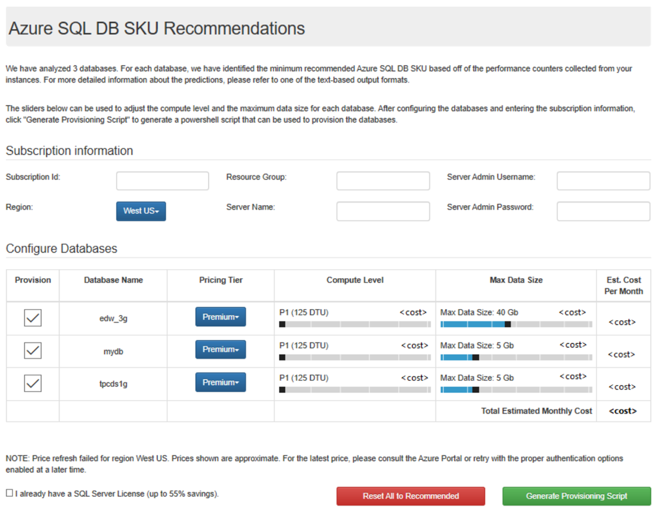
Identify the right Azure SQL Database/MI SKU for your on-premises database (I/II)
Database Migration Assistant (DMA)
Elastic pools
Managed instance
Single database
Notes:
Migrating databases to the cloud can be complicated, especially when trying to select the best Azure database target and SKU for your database. Our goal with the Database Migration Assistant (DMA) is to help address these questions and make your database migration experience easier by providing these SKU recommendations in a user-friendly output.
DMA's Azure SQL Database SKU recommendations feature. Azure SQL Database has several deployment options, including:
Single database
Elastic pools
Managed instance

Slide 42
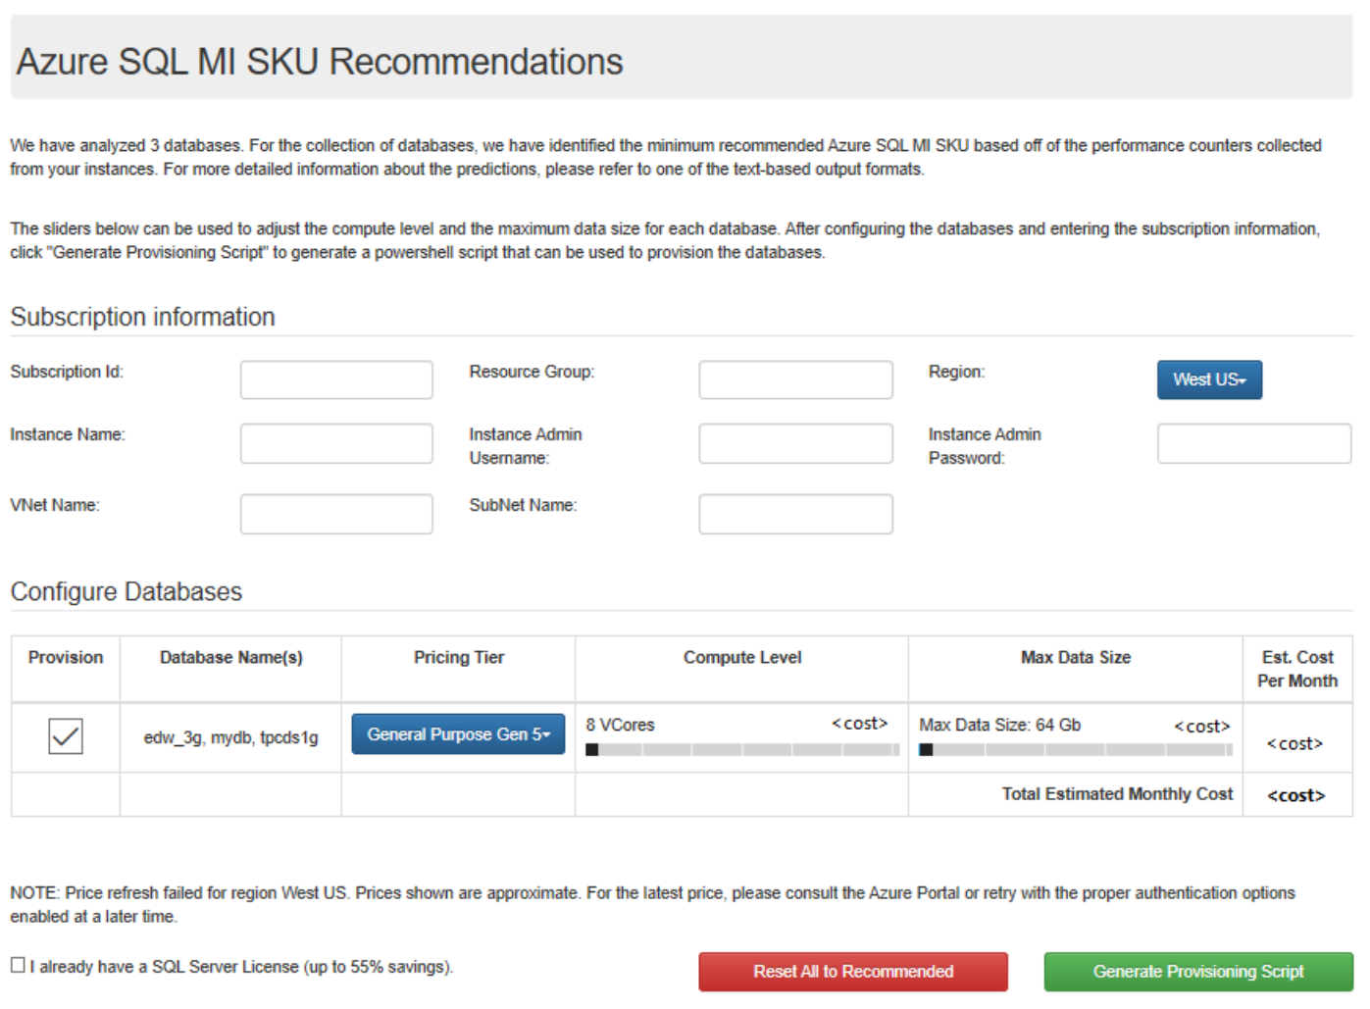
Identify the right Azure SQL Database/MI SKU for your on-premises database (II/II)
The feature provides recommendations related to:
pricing tier
compute level
max data size
estimated cost per month.
Furthermore offers the ability to bulk provision single databases and managed instances in Azure for all recommended databases.
Notes:
The SKU Recommendations feature allows you to identify both the minimum recommended Azure SQL Database single database or managed instance SKU based on performance counters collected from the computer(s) hosting your databases. The feature provides recommendations related to pricing tier, compute level, and max data size, as well as estimated cost per month. It also offers the ability to bulk provision single databases and managed instances in Azure for all recommended databases.

Slide 43

Questions?

Slide 44
Knowledge Check
What are the differences between IaaS, PaaS, SaaS and where should you position Azure SQL Database?
What are the two purchasing models available?
What are the three vCore-based purchasing models that Azure SQL Database offers?
What are the differences between a provisioned compute tier and a serverless compute tier?
Which are the two deployment options that can use DTU-based or the vCore-based purchasing model?
Notes:
Q1: What are the differences between IaaS, PaaS, SaaS and where should you position Azure SQL Database?
Answer 1:
Infrastructure as a Service (IaaS) is similar to traditional hosting, where a business will use the hosted environment as a logical extension of the on-premises datacenter. The servers (physical and virtual) are rented on an as-needed basis, and the IT professionals who manage the infrastructure have full control of the software configuration.
Platform as a Service (PaaS) offers hosted application servers that have near-infinite scalability resulting from the large resource pools they rely on. PaaS also offers necessary supporting services like storage, security, integration infrastructure and development tools for a complete platform.
Software as a Service (SaaS) is a software delivery business model in which a provider or third party hosts an application and makes it available to customers on a subscription basis.
Azure SQL Database is positioned under a PaaS solution
Q2: What are the two Purchasing models?
Answer 2:
DTU-based model and v-Core Based
Q3: What are the three vCore-based purchasing models that Azure SQL Database offers?
Answer 3:
General purpose, hyperscale, and business critical
These service tiers are differentiated by a range of compute sizes, high-availability designs, fault-isolation methods, types and sizes of storage, and I/O ranges.
Q4: What are the differences between provisioned compute tier and a serverless compute tier?
Answer 4:
With the provisioned compute tier, you choose the exact amount of compute resources that are always provisioned for your workload. With the serverless compute tier, you specify the autoscaling of the compute resources over a configurable compute range.
With this serverless compute tier, you can also automatically pause and resume the database based on workload activity.
The vCore unit price per unit of time is lower in the provisioned compute tier than it is in the serverless compute tier.
Q5: Which are the two deployment options that can use DTU-based or the vCore-based purchasing model?
Answer 5:
Single database and Elastic pool

Slide 45
Lesson 2: How to create Azure SQL Database
Notes:
In this lesson we will be covering the prerequisites for Azure SQL Database and how to create a database.

Slide 46
Objectives
After completing this learning, you will be able to:
Know which prerequisites are needed before you can create an Azure SQL Database.
Create your first Azure SQL Database.

Slide 47
Azure SQL Database Server is not a machine...
SQL Server
A Machine
Azure SQL Database Server
TDS* Endpoint
*TDS = Tabular Data Stream
Notes:
A SQL Server is typically hosted on a physical or virtual machine and is referred to as an “instance” of SQL Server.
An Azure SQL Database Server is referred to as a logical server. It looks like a SQL Server instance, but it is technically a TDS (Tabular Data Stream) endpoint running as a microservice. Azure routes your requests to the physical primary replica of the database.

Slide 48
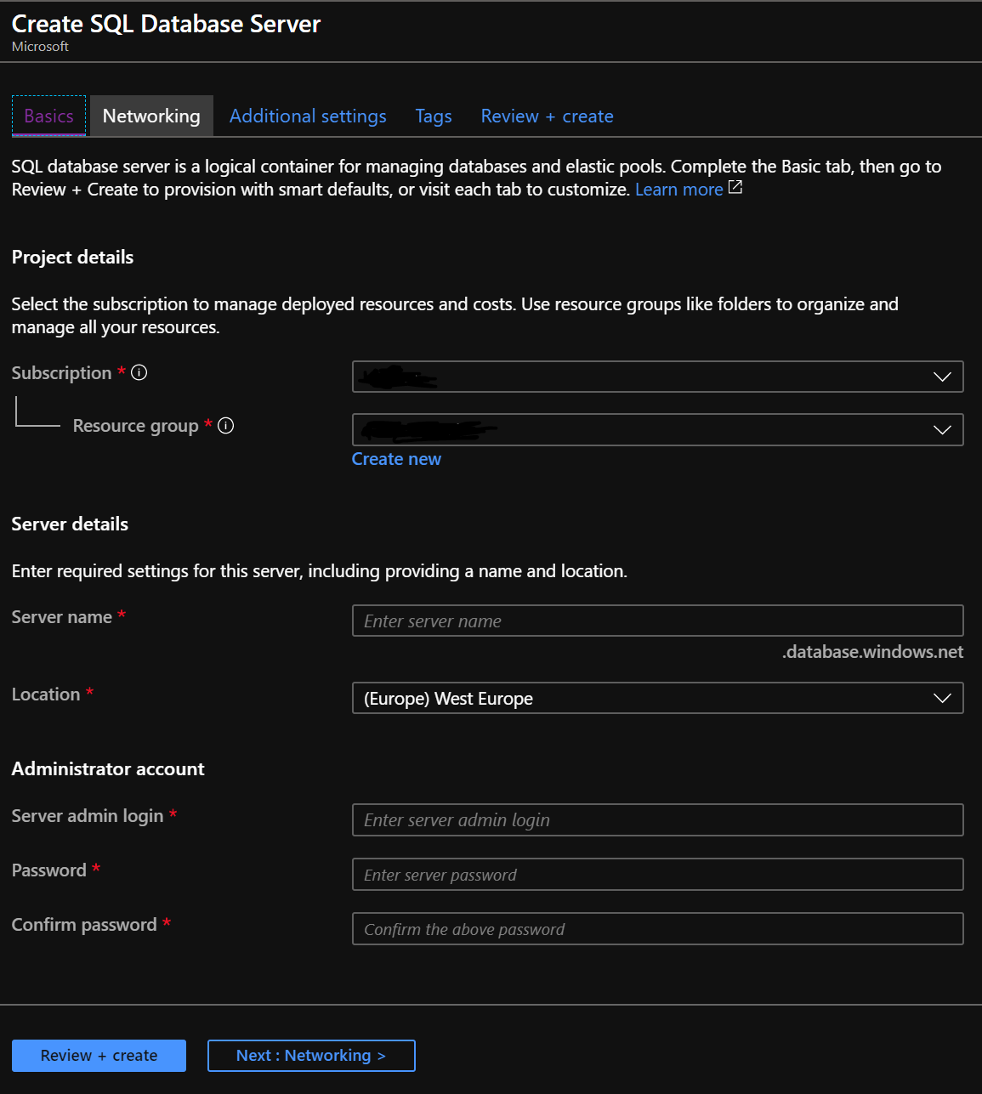
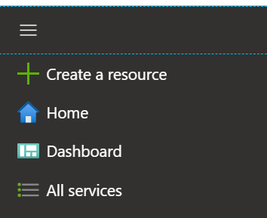
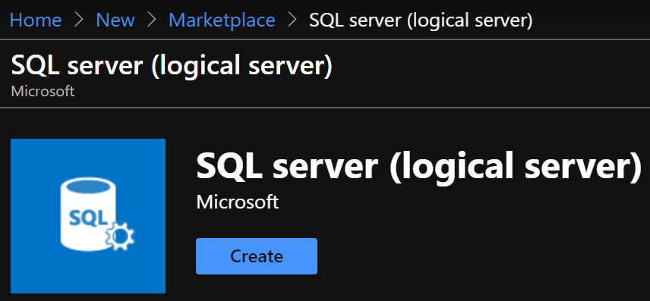
Server Provisioning
Service head that contains databases
Connect via Fully Qualified Domain Name
Initially contains only a master database
Notes:
We have the concept of a logical SQL Server but it’s just a logical grouping of databases.
You get a Fully Qualified Domain Name (FQDN) from Azure. That’s included in your connections string as normal and initially the only database visible is the master system database
To provision a logical SQL Server using the Azure Portal:
Log on to the portal
Select ‘Create a resource’
Search the Marketplace box for ‘SQL server (logical server)’
Click Create
Specify the following parameters:
Basics
Subscription
Resource group
Server name
Location
Server admin login
Password
Networking
Firewall rules, allow Azure services and resources to access this server (Yes/No)
Advanced data security
Enable advanced data security (Start free trial/Not now)
You can also use Azure PowerShell or Command Line Interface (CLI) to provision the logical SQL Server.

Slide 49
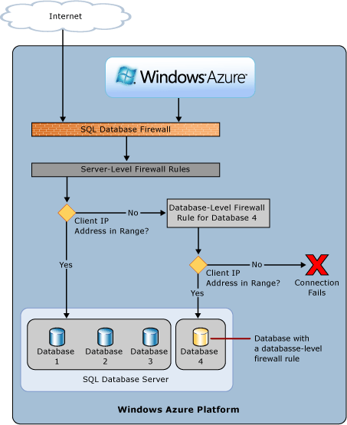
Azure SQL Database Firewall
IP Address-based access control for SQL Database
Rules at the server and/or database level
No IP authorized by default, not even Azure itself
Notes:
Firewall overview
Initially, all Transact-SQL access to your Azure SQL Server is blocked by the firewall. To begin using your Azure SQL Server, you can specify one or more server-level firewall rules that enable access. Use the firewall rules to specify which IP address ranges from the Internet are allowed, and whether Azure applications can attempt to connect to your Azure SQL Server. Of course, additionally, a login and password is still required for access.
To selectively grant access to just one of the databases in your Azure SQL Server, you must create a database-level rule for the required database. Specify an IP address range for the database firewall rule that is outside the IP address range specified in the server-level firewall rule, and ensure that the IP address of the client falls in the range specified in the database-level rule.
Connection attempts from the Internet and Azure must first pass through the firewall before they can reach your Azure SQL Server or SQL Database, as shown in the diagram:
Server-level firewall rules: These rules enable clients to access your entire Azure SQL Server, that is, all the databases within the same logical server. These rules are stored in the master database. Server-level firewall rules can be configured by using the portal or by using Transact-SQL statements. To create server-level firewall rules using the Azure portal or PowerShell, you must be the subscription owner or a subscription contributor. To create a server-level firewall rule using Transact-SQL, you must connect to the SQL Database instance as the server-level principal login or the Azure Active Directory administrator (which means that a server-level firewall rule must first be created by a user with Azure-level permissions).
Database-level firewall rules: These rules enable clients to access certain (secure) databases within the same logical server. You can create these rules for each database (including the master database) and they are stored in the individual databases. Database-level firewall rules for master and user databases can only be created and managed by using Transact-SQL statements and only after you have configured the first server-level firewall. If you specify an IP address range in the database-level firewall rule that is outside the range specified in the server-level firewall rule, only those clients that have IP addresses in the database-level range can access the database. You can have a maximum of 128 database-level firewall rules for a database. For more information on configuring database-level firewall rules, see the example later in this article and see sp_set_database_firewall_rule (Azure SQL Databases).
Recommendation: Microsoft recommends using database-level firewall rules whenever possible to enhance security and to make your database more portable. Use server-level firewall rules for administrators and when you have many databases that have the same access requirements and you don't want to spend time configuring each database individually.
Further details will be discussed in the security module.

Slide 50
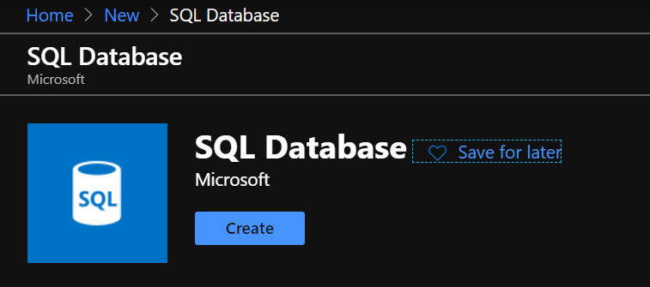
Create the database
Portal
PowerShell:
New-AzSqlDatabase -ResourceGroupName "reurcegroupsqlgsps"
-ServerName "server1" -DatabaseName "database1"
-Edition "Standard" -RequestedServiceObjectiveName "S1"
Transact-SQL:
CREATE DATABASE MyFirstAzureSQLDatabase
(MAXSIZE = 500 MB, EDITION = 'standard', SERVICE_OBJECTIVE = 'S1');
Notes:
Shown on the slide are 3 example ways to create an Azure SQL Database:
Azure Portal
Azure PowerShell
Transact-SQL
It can also be created with a JSON file, example https://raw.githubusercontent.com/Azure/azure-docs-json-samples/master/SQLServerAndDatabase/azuredeploy.json.

Slide 51
Demonstration
Create your first Azure SQL Database
Create a new server, configure the firewall rules and create an Azure SQL Database (DTU based).
Notes:
M01L02Demo01
Demo setup instructions
The latest version of the SQL Server Management Studio
Steps
Connect to the Azure Portal, click on “Create a resource” and search for SQL Server (logical server)
Create a logical server
Server Name myazuresrv (if the name is already in use, try another name until you notice that it’s not yet in use)
Server Admin Login AzureAdmin
Password Passw0rd1
Confirm password Passw0rd1
Subscription Select your subscription
Resource Group Create New and specify the name AzureDB-RG
Location Select the location that is the closest to your location
3. Examine the different server options (Failover Groups, Manage backups, AD Admin, Security, Automatic Tuning…) Give a short overview, not in detail because this will be discussed later in the Workshop.
4. Create the firewall rules on the logical server. Add the Client IP address.
5. Create Azure SQL Database with the portal. Go to your logical server – Overview – Click on New database
Database name Salesdb
Source Database Blank Database
Server This should be your logical server name
Want to use SQL elastic pool? Not now
Pricing Tier Basic
Collation SQL_Latin1_General_CP1_CI_AS

Slide 52
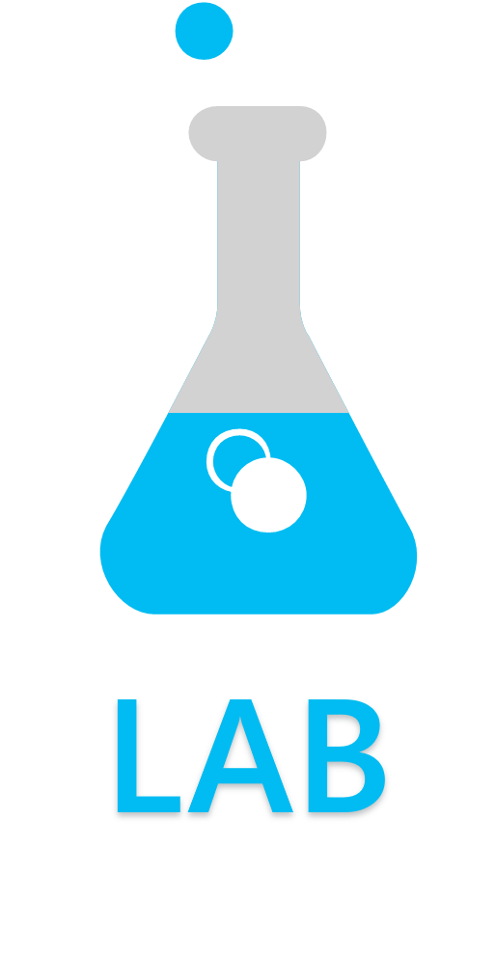
Create an Azure SQL Database
Exercise 1: Create a new SQL Server (logical server).
Exercise 2: Create firewall rules.
Exercise 3: Create an Azure SQL. Database (DTU Based).
Notes:
M01L02Lab01

Slide 53
Questions?

Slide 54
Knowledge Check
Why do you need to configure the Azure SQL Database Firewall and why is it important?
What options do you need to specify to create an Azure SQL Database?
What is a SQL server (logical server)?
Notes:
Q1: Why do you need to configure the Azure SQL Database Firewall and why is it important?
Answer 1:
Initially, all Transact-SQL access to your Azure SQL server is blocked by the firewall. To begin using your Azure SQL Server, you can specify one or more server-level firewall rules that enable access to your Azure SQL server. Use the firewall rules to specify which IP address ranges from the Internet are allowed, and whether Azure applications can attempt to connect to your Azure SQL server.
To selectively grant access to just one of the databases in your Azure SQL server, you must create a database-level rule for the required database. Specify an IP address range for the database firewall rule that is outside the IP address range specified in the server-level firewall rule, and ensure that the IP address of the client falls in the range specified in the database-level rule.
hat options do you need to specify to create an Azure SQL Database?
Q2: What options do you need to specify to create an Azure SQL Database?
Answer 2:
Database Name
Source
Resource Group
Server Admin and password
Pricing Tier
Collation
Q3: What is a SQL server (logical server)?
Answer 3:
It is a logical construct that acts as a central administrative point for multiple single or pooled databases, logins, firewall rules, auditing rules, threat detection policies, and failover groups.
The SQL logical server must exist before you can create the Azure SQL database. All databases managed by a SQL logical server are created within the same region as the SQL logical server.

Slide 55
Lesson 3: Introduction to Elastic Database Pools in Azure SQL Database
Notes:
In this lesson we will be covering the to Elastic Database Pools in Azure SQL Database.

Slide 56
Objectives
After completing this learning, you will be able to:
Describe the Azure Elastic Database Pool

Slide 57

What is an Azure SQL elastic pool?
Notes:
https://docs.microsoft.com/en-us/azure/sql-database/sql-database-elastic-pool
Show the following overview Video to the class:
https://sec.ch9.ms/ch9/5022/64e0e193-2792-4a62-854e-31ae76365022/ElasticDatabasePools_mid.mp4

Slide 58
What is an Azure SQL elastic pool?
Managing and scaling multiple databases that have varying and unpredictable usage demands.
Provisioning resources for the entire pool. It is a cost-effective solution for running multiple data bases with a fixed Budget.
Simply add and remove databases with downtime.
A pool is shared by multiple databases to accommodate unpredictable periods of usage by individual databases.
Notes:
SQL Database elastic pools are a simple, cost-effective solution for managing and scaling multiple databases that have varying and unpredictable usage demands. The databases in an elastic pool are on a single Azure SQL Database server and share a set number of resources at a set price. Elastic pools in Azure SQL Database enable SaaS developers to optimize the price performance for a group of databases within a prescribed budget while delivering performance elasticity for each database.
Elastic pools enable the developer to purchase resources for a pool shared by multiple databases to accommodate unpredictable periods of usage by individual databases. You can configure resources for the pool based either on the DTU-based purchasing model or the vCore-based purchasing model. The resource requirement for a pool is determined by the aggregate utilization of its databases. The amount of resources available to the pool is controlled by the developer budget. The developer simply adds databases to the pool, sets the minimum and maximum resources for the databases (either minimum and maximum DTUs or minimum or maximum vCores depending on your choice of resourcing model), and then sets the resources of the pool based on their budget. A developer can use pools to seamlessly grow their service from a lean startup to a mature business at ever-increasing scale.
Within the pool, individual databases are given the flexibility to auto-scale within set parameters. Under heavy load, a database can consume more resources to meet demand. Databases under light loads consume less, and databases under no load consume no resources. Provisioning resources for the entire pool rather than for single databases simplifies your management tasks. Plus, you have a predictable budget for the pool. Additional resources can be added to an existing pool with no database downtime, except that the databases may need to be moved to provide the additional compute resources for the new eDTU reservation. Similarly, if extra resources are no longer needed they can be removed from an existing pool at any point in time. And you can add or subtract databases to the pool. If a database is predictably under-utilizing resources, move it out.

Slide 59
DTU-based Elastic Pool service tiers
 | Basic | Standard | Premium
Built for | Light transactional workloads | Medium transactional workloads | Heavy transactional workloads
Available SLA | 99.99%
eDTUs per pool | 50-1,600 | 50-3,000 | 125-4,000
Max number of databases per pool | 100-500 | 100-500 | 50-100
Max eDTUS choices per data bases | 5 | 10-3000 | 25-4,000
Max storage per pool | 5-156 GB | 4 TB | 4 TB
Max storage per database | 2 GB | 500 GB -1 TB | 1 TB
Point-in-time restore (“oops” recovery) | Any point within 7 days | 7-35 days (7 days by default)
Business continuity | Active geo-replication, up to four readable secondary backups
Security | Auditing, row-level security, dynamic data masking
Performance objectives | Transactions per hour | Transactions per minute | Transactions per second
Elastic pool: Storage sizes and compute sizes
Notes:
Resources limits for elastic pools using the DTU-based purchasing model:
https://docs.microsoft.com/en-us/azure/sql-database/sql-database-dtu-resource-limits-elastic-pools

Slide 60
vCore-based Elastic Pool service tiers - General Purpose
 | Gen5 | Fsv2-series
vCores | 2 - 80 | 72
Memory (GB) | 10.2 - 408 | 136
Max number of DBs per pool | 100 - 500 | 500
Storage type | Premium (remote) storage | Premium (remote) storage
Max data size | 512 GB – 4 TB | 4 TB
Max log size | 154 GB – 1229 GB | 1 TB
Max tempdb size | 64 GB - 384 GB | 333 GB
Number of replicas | 1 | 1
Resource limits for elastic pools using the vCore-based purchasing model limits
Notes:
Resource limits for elastic pools using the vCore-based purchasing model limits:
https://docs.microsoft.com/en-us/azure/sql-database/sql-database-vcore-resource-limits-elastic-pools

Slide 61
vCore-based Elastic Pool service tiers - Business Critical
 | Gen5 | M-series
vCores | 4 - 80 | 128
Memory (GB) | 20.4 - 408 | 3767
Max number of DBs per pool | 100 | 100
Storage type | Local SSD | Local SSD
Max data size | 1 TB – 4 TB | 4 TB
Max log size | 307 GB – 1229 GB | 2 TB
Max tempdb size | 128 GB - 384 GB | 4 TB
Number of replicas | 4 | 4
Resource limits for elastic pools using the vCore-based purchasing model limits
Notes:
Resource limits for elastic pools using the vCore-based purchasing model limits:
https://docs.microsoft.com/en-us/azure/sql-database/sql-database-vcore-resource-limits-elastic-pools

Slide 62
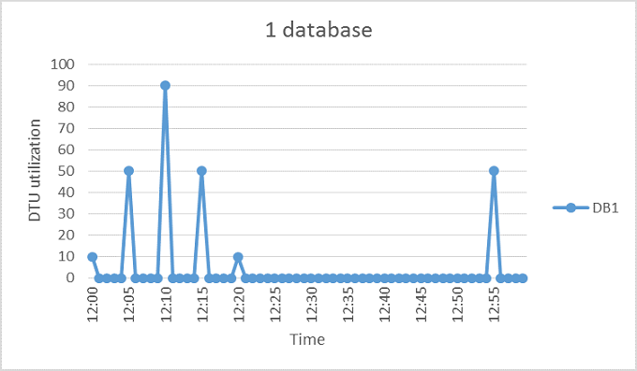
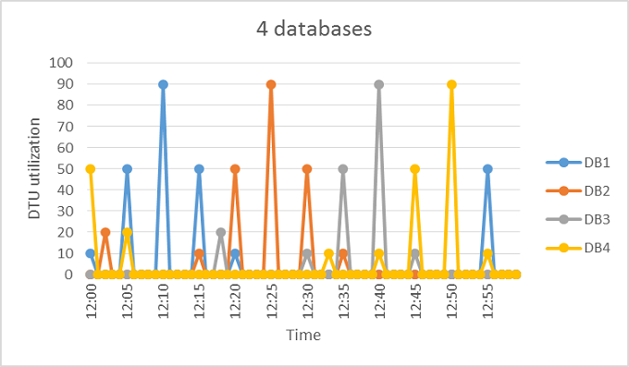
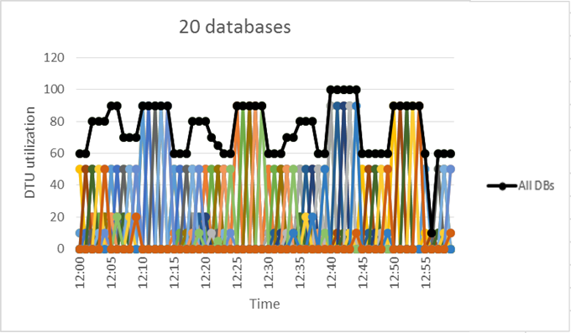
When to consider a pool?
Assessing database utilization patterns.
There are large differences between peak utilization and average utilization per database.
The peak utilization for each database occurs at different points in time.
eDTUs are shared between many databases.
Notes:
Databases that are great candidates for elastic pools typically have periods of activity and other periods of inactivity. In the example above you see the activity of a single database, 4 databases, and finally an elastic pool with 20 databases. Databases with varying activity over time are great candidates for elastic pools because they are not all active at the same time and can share eDTUs. Not all databases fit this pattern. Databases that have a more constant resource demand are better suited to the Basic, Standard, and Premium service tiers where resources are individually assigned.
For the five-minute period illustrated, DB1 peaks up to 90 DTUs, but its overall average usage is less than five DTUs. An S3 performance level is required to run this workload in a single database, but this leaves most of the resources unused during periods of low activity.
A pool allows these unused DTUs to be shared across multiple databases, and so reduces the DTUs needed and overall cost.
Building on the previous example, suppose there are additional databases with similar utilization patterns as DB1. In the next two figures below, the utilization of four databases and 20 databases are layered onto the same graph to illustrate the non-overlapping nature of their utilization over time.
The aggregate DTU utilization across all 20 databases is illustrated by the black line in the preceding figure. This shows that the aggregate DTU utilization never exceeds 100 DTUs, and indicates that the 20 databases can share 100 eDTUs over this time period. This results in a 20x reduction in DTUs and a 13x price reduction compared to placing each of the databases in S3 performance levels for single databases.

Slide 63
Rules of Thumb
DTU
vCore
Minimum number of databases
The sum of the DTUs of performance levels for single databases is more than 1.5x the eDTUs needed for the pool.
Maximum number of concurrently peaking databases
Not more than 2/3 (or 67%) of the databases in the pool should simultaneously peak to their eDTU limit.
DTU utilization per database
A database should be considered for a pool when its peak utilization is about 1.5 times greater than its average utilization.
Maximum number of vCores
The minimum number of vCores
Set max vCores per database high enough to handle peaks in database utilization.
The product of the number of databases in the pool and the minimum vCores per database cannot exceed the vCores per pool.
Max database size refers to the maximum size of the data files and does not include the space used by log files.
Max storage per database
The maximum database size set by the user for a database in a pool.
The maximum number of vCores that any database in the pool may use, if available based on utilization by other databases in the pool.
The minimum number of vCores that any database in the pool is guaranteed.
Notes:
The following rules of thumb related to database count and database utilization help to ensure that a pool delivers reduced cost compared to using performance levels for single databases.
Minimum number of databases
If the sum of the DTUs of performance levels for single databases is more than 1.5x the eDTUs needed for the pool, then an elastic pool is more cost effective. For available sizes, see eDTU and storage limits for elastic pools and elastic databases.
Example At least two S3 databases or at least 15 S0 databases are needed for a 100 eDTU pool to be more cost-effective than using performance levels for single databases.
Maximum number of concurrently peaking databases
By sharing eDTUs, not all databases in a pool can simultaneously use eDTUs up to the limit available when using performance levels for single databases. The fewer databases that concurrently peak, the lower the pool eDTU can be set and the more cost-effective the pool becomes. In general, not more than 2/3 (or 67%) of the databases in the pool should simultaneously peak to their eDTU limit.
Example To reduce costs for three S3 databases in a 200 eDTU pool, at most two of these databases can simultaneously peak in their utilization. Otherwise, if more than two of these four S3 databases simultaneously peak, the pool would have to be sized to more than 200 eDTUs. If the pool is resized to more than 200 eDTUs, more S3 databases would need to be added to the pool to keep costs lower than performance levels for single databases.
Note this example does not consider utilization of other databases in the pool. If all databases have some utilization at any given point in time, then less than 2/3 (or 67%) of the databases can peak simultaneously.+
DTU utilization per database
A large difference between the peak and average utilization of a database indicates prolonged periods of low utilization and short periods of high utilization. This utilization pattern is ideal for sharing resources across databases. A database should be considered for a pool when its peak utilization is about 1.5 times greater than its average utilization.
Example An S3 database that peaks to 100 DTUs and on average uses 67 DTUs or less is a good candidate for sharing eDTUs in a pool. Alternatively, an S1 database that peaks to 20 DTUs and on average uses 13 DTUs or less is a good candidate for a pool.
Max vCores per database
The maximum number of vCores that any database in the pool may use, if available based on utilization by other databases in the pool. Max vCores per database is not a resource guarantee for a database. This setting is a global setting that applies to all databases in the pool. Set max vCores per database high enough to handle peaks in database utilization. Some degree of over-committing is expected since the pool generally assumes hot and cold usage patterns for databases where all databases are not simultaneously peaking.
Min vCores per database
The minimum number of vCores that any database in the pool is guaranteed. This setting is a global setting that applies to all databases in the pool. The min vCores per database may be set to 0, and is also the default value. This property is set to anywhere between 0 and the average vCores utilization per database. The product of the number of databases in the pool and the min vCores per database cannot exceed the vCores per pool.
Max storage per database
The maximum database size set by the user for a database in a pool. Pooled databases share allocated pool storage, so the size a database can reach is limited to the smaller of remaining pool storage and database size. Max database size refers to the maximum size of the data files and does not include the space used by log files.

Slide 64
Impact of changing service tier or rescaling compute size
Create new compute instance for the elastic pool
A new compute instance for the elastic pool is created with the requested service tier and compute size.
Regardless, the databases remain online during this step, and connections continue to be directed to the databases in the original compute instance.
Switch routing of connections to new compute instance
Existing connections to the databases in the original compute instance are dropped.
Any new connections are established with the databases in the new compute instance. Accelerated Database Recovery can reduce the impact from aborting long running transactions.
No data is lost during any step in the workflow
Notes:
Change compute resources (vCores or DTUs)
After initially picking the number of vCores or eDTUs, you can scale an elastic pool up or down dynamically based on actual experience using the Azure portal, PowerShell, the Azure CLI, or the REST API.
Impact of changing service tier or rescaling compute size
Changing the service tier or compute size of an elastic pool follows a similar pattern as for single databases and mainly involves the service performing the following steps:
Create new compute instance for the elastic pool
A new compute instance for the elastic pool is created with the requested service tier and compute size. For some combinations of service tier and compute size changes, a replica of each database must be created in the new compute instance which involves copying data and can strongly influence the overall latency. Regardless, the databases remain online during this step, and connections continue to be directed to the databases in the original compute instance.
Switch routing of connections to new compute instance
Existing connections to the databases in the original compute instance are dropped. Any new connections are established to the databases in the new compute instance. For some combinations of service tier and compute size changes, database files are detached and reattached during the switch. Regardless, the switch can result in a brief service interruption when databases are unavailable generally for less than 30 seconds and often for only a few seconds. If there are long running transactions running when connections are dropped, the duration of this step may take longer in order to recover aborted transactions. Accelerated Database Recovery can reduce the impact from aborting long running transactions.
Important
No data is lost during any step in the workflow.

Slide 65
Sizing an Elastic Pool
Cost of under utilization: When rescaling vCores or eDTUs for an elastic pool, an extra storage cost applies if (1) the storage max size of the pool is supported by the target pool, and (2) the storage max size exceeds the included storage amount of the target pool.
Usage History: Azure DB evaluates historical resource usage.
Billing Size: You are billed for each hour a database exists using the highest service tier + compute size that applied during that hour, regardless of usage or whether the database was active for less than an hour.
Storage Max Size: When downsizing vCores or eDTUs for an elastic pool, the pool used space must be smaller than the maximum allowed size of the target service tier and pool eDTUs.
Notes:
The best size for a pool depends on the aggregate eDTUs and storage resources needed for all databases in the pool. This involves determining the larger of the following:
Maximum DTUs utilized by all databases in the pool.
Maximum storage bytes utilized by all databases in the pool.
SQL Database automatically evaluates the historical resource usage of databases in an existing SQL Database server and recommends the appropriate pool configuration in the Azure portal. In addition to the recommendations, a built-in experience estimates the eDTU usage for a custom group of databases on the server. This enables you to do a "what-if" analysis by interactively adding databases to the pool and removing them to get resource usage analysis and sizing advice before committing your changes.
When rescaling eDTUs for an elastic pool, an extra storage cost applies if (1) the storage max size of the pool is supported by the target pool, and (2) the storage max size exceeds the included storage amount of the target pool. For example, if a 100 eDTU Standard pool with a max size of 100 GB is downsized to a 50 eDTU Standard pool, then an extra storage cost applies since target pool supports a max size of 100 GB and its included storage amount is only 50 GB. So, the extra storage amount is 100 GB – 50 GB = 50 GB.
For more information:
https://docs.microsoft.com/en-us/azure/sql-database/sql-database-elastic-pool-scale

Slide 66
Change elastic pool storage size
vCore-based purchasing model
Storage can be provisioned up to the max size limit:
DTU-based purchasing model
The eDTU price for an elastic pool includes a certain amount of storage at no additional cost.
Extra storage beyond the included amount can be provisioned for an additional cost up to the max size limit in increments of 250 GB up to 1 TB, and then in increments of 256 GB beyond 1 TB.
The price of extra storage for an elastic pool is the extra storage amount multiplied by the extra storage unit price of the service tier.
For storage in the standard or general-purpose service tiers, increase or decrease size in 10GB increments.
For storage in the premium or business critical service tiers, increase or decrease size in 250GB increments.
The price of storage for an elastic pool is the storage amount multiplied by the storage unit price of the service tier.
Notes:
vCore-based purchasing model
Storage can be provisioned up to the max size limit:
For storage in the standard or general purpose service tiers, increase or decrease size in 10-GB increments
For storage in the premium or business critical service tiers, increase or decrease size in 250-GB increments
Storage for an elastic pool can be provisioned by increasing or decreasing its max size.
The price of storage for an elastic pool is the storage amount multiplied by the storage unit price of the service tier. For details on the price of extra storage, see SQL Database pricing.
DTU-based purchasing model
The eDTU price for an elastic pool includes a certain amount of storage at no additional cost. Extra storage beyond the included amount can be provisioned for an additional cost up to the max size limit in increments of 250 GB up to 1 TB, and then in increments of 256 GB beyond 1 TB. For included storage amounts and max size limits, see Elastic pool: storage sizes and compute sizes.
Extra storage for an elastic pool can be provisioned by increasing its max size using the Azure portal, PowerShell, the Azure CLI, or the REST API.
The price of extra storage for an elastic pool is the extra storage amount multiplied by the extra storage unit price of the service tier. For details on the price of extra storage, see SQL Database pricing.

Slide 67
Demonstration
Create an Elastic Pool
Create an Elastic pool using the Azure portal
Notes:
M01L03Demo01
Go to the Azure portal
In the Azure Portal, you can create elastic pools on either an existing server and move your existing Azure SQL databases into it or create a new server.
In our case, for this demonstration we will navigate to the existing Azure SQL Logical Server and click on + New pool to create a pool directly into that server.
Show the students the options to create an Elastic Pool.
When the pool is created show the different options, navigate to configure pool blade:
Change the service tier of the pool
Scale the performance (DTU or vCores) and storage up or down
Add or remove databases to/from the pool
Set a min (guaranteed) and max performance limit for the databases in the pools
Review the cost summary to view any changes to your bill as a result of your new selections
If the time permit, you can create a new database and move it into the pool in order to show further details.
Note: just to give an estimation an Elastic Pool with 200 eDTUs (standard) and 250 GB storage costs about the same as 15 single databases with 20 DTUs each (standard) and 250 GB storage each.

Slide 68
Questions?

Slide 69
Knowledge Check
What is a SQL Elastic Pool?
When should you consider an elastic pool instead of a single database?
Which tools can help you to size your elastic pool?
Notes:
Question 1: What is a SQL Elastic Pool?
Answer 1:
A pool is given a set number of eDTUs, for a set price. Within the pool, individual databases are given the flexibility to auto-scale within set parameters. Under heavy load, a database can consume more eDTUs to meet demand. Databases under light loads consume less, and databases under no load consume no eDTUs. Provisioning resources for the entire pool rather than for single databases simplifies your management tasks. Plus you have a predictable budget for the pool.
Question 2: When should you consider an elastic pool instead of a single database?
Answer 2:
Average utilization per database.
The peak utilization for each database occurs at different points in time.
eDTUs are shared between many databases.
Question 3: Which tools can help you to size your elastic pool?
Answer 3:
Azure DB evaluates historical resource usage
A built-in experience estimates the eDTU usage for a custom group of databases on the server.

Slide 70
Lesson 4: The difference between SQL Server IaaS and PaaS Solutions
Notes:
In this lesson we will be discussing the key differences between SQL Server Iaas and PaaS solutions.

Slide 71
Objectives
After completing this learning, you will be able to:
Know the differences between SQL Server on an Azure VM and Azure SQL Database and in which scenario you should opt for an IaaS or PaaS solution.

Slide 72
Data platform continuum
PaaS & SaaS
Azure SQL Database
Virtualized Database
Shared lower cost
IaaS
SQL Server in Azure VM
Virtualized Machines
Virtual
SQL Server Private Cloud
Virtualized Machine + Appliance
Physical
SQL Server
Physical Machine (raw iron)
Dedicated higher cost
Higher administration
Lower administration
Notes:
Objective: One of the first things to understand in any discussion of Azure versus on-premises SQL Server databases is that you can use it all. The Microsoft data platform leverages SQL Server technology and makes it available across physical on-premises machines, private cloud environments, third-party hosted private cloud environments, and public cloud. This enables you to meet unique and diverse business needs through a combination of on-premises and cloud-hosted deployments, while using the same set of server products, development tools, and expertise across these environments.
Talking Points:
As seen in the diagram, each offering can be characterized by the level of administration you have over the infrastructure (on the X axis), and by the degree of cost efficiency achieved by database level consolidation and automation (on the Y axis).
When designing an application, four basic options are available for hosting the SQL Server part of the application:
SQL Server on nonvirtualized physical machines
SQL Server in on-premises virtualized machines (private cloud)
SQL Server in Azure Virtual Machine (public cloud)
Azure SQL Database (public cloud)

Slide 73
A closer look… Best for
Azure SQL Datababase
New cloud-designed applications that want to use the latest stable SQL Server features and have time constraints in development and marketing.
Teams that need built-in high availability, disaster recovery, and upgrade for the database.
Teams that do not want to manage the underlying operating system and configuration settings.
Databases of up to 4 TB, or larger databases that can be horizontally or vertically partitioned using a scale-out pattern.
Managed Instance
New applications or existing on-premises applications that want to use the latest stable SQL Server features and that are migrated to the cloud with minimal changes.
Teams that need built-in high availability, disaster recovery, and upgrade for the database.
Teams that do not want to manage the underlying operating system and configuration settings.
Databases of up to 8 TB, or larger databases that can be horizontally or vertically partitioned using a scale-out pattern.
SQL Server in Azure VM
Existing applications that require fast migration to the cloud with minimal changes or no changes.
Teams that can configure, fine tune, customize, and manage high availability, disaster recovery, and patching for SQL Server.
You need a customized environment with full administrative rights.
SQL Server instances with up to 64 TB of storage. The instance can support as many databases as needed.
Notes:
Listed are the most common motivations to choose an Azure SQL Database or SQL Server running on an Azure VM or a Managed Instance as a hybrid solution.

Slide 74
Azure SQL Database developer’s intelligent cloud database service
Built for application developers.
Gives developers more time to innovate.
Accelerates time to market.
Maximizes performance, reliability, and data protection.
Allows developers to use the languages and platforms they prefer.
Everything built-in
Notes:
Objective: Azure SQL Database is the intelligent cloud database service built for application developers. It’s the only cloud database service that scales anytime, anywhere without downtime and helps you efficiently deliver multitenant applications―ultimately giving you more time to innovate and accelerating your time to market.
Talking Points:
Built-in advisors quickly learn your application’s unique characteristics and dynamically adapt to maximize performance, reliability, and data protection
And you can build applications and connect to your database using the languages and platforms you prefer, with the confidence that SQL Database is secure and handles the mundane administrative tasks for you

Slide 75
Azure SQL Database — Everything built-in
Business continuity
High availability
Automated backups
Long term backup retention
Geo-replication
Scale
Advanced security
Automatic tuning
Built-in monitoring
Built-in intelligence
Notes:
Business continuity enables your business to continue operating in the face of disruption, particularly to its computing infrastructure.
High availability of Azure SQL Database guarantees your databases are up and running 99.99% of the time, no need to worry about maintenance/downtimes.
2 read replicas - GP
3 replicas, 1 read-scale replica, zone-redundant HA - BC
Primary read/write replica + up to 4 read replicas - HS
Automated backups are created and use Azure read-access geo-redundant storage (RA-GRS) to provide geo-redundancy.
Also Point in Time restore.
Long term backup retention enables you to store specific full databases for up to 10 years.
Geo-replication by creating readable replicas of your database in the same or different data center (region). You can manually failover to readable replicas
Also Auto-failover groups allows an application to recover in case of a data center outage
Scale by easily adding more resources (CPU, memory, storage) without long provisioning.
Advanced security detects threats and vulnerabilities in your databases and enables you to secure your data.
Automatic tuning analyzes your workload and provides you the recommendations that can optimize performance of your applications by adding indexes, removing unused indexes, and automatically fixing the query plan issues.
Built-in monitoring capabilities enable you to get the insights into performance of your databases and workload, and troubleshoot the performance issues.
Built-in intelligence automatically identifies the potential issues in your workload and provides you the recommendations that can help you to fix the problems.

Slide 76

Azure SQL Database — Everything built in
VMs
configurable
Business continuity
High availability
Automated backups
Long term backup retention
Geo-replication
Scale
Advanced security
Automatic tuning
Built-in monitoring
Built-in intelligence
Notes:
Configurable could be replaced with “choice of automation”
SQL VM with defaults; “automated security patching” comes as built-in.
But, can use services (automations provided by Microsoft for free) to enable:
-HA for an SLA they choose, either 99.95% or 99.99%
-Automated backup
-Advanced threat detection and vulnerability assessment
They can do the followings manually, but we do not have an automation for that:
-Add readable DR replica in same region; different zone
-Add a Geo-Dr replica
With VM deployment type they can “Control” the level of Managebility they prefer.
E.g., do not have to sacrifice their patching or update policies to get automated HADR.
Can choose form available administration services and configure only the ones they prefer.
Flexible platform where you can add-on the services they want and keep manual maintenance on others.

Slide 77
Total Application Cost
When using Azure SQL Database
Total cost of application = Highly minimized administration costs + software development costs + Azure SQL Database service costs
When using SQL Server in Azure VM
Total cost of application = Minimized software development/modification costs + administration costs + SQL Server & Windows Server licensing costs + Azure Storage costs
Notes:
You can use the Azure Pricing Calculator to calculate your total application cost when using Azure SQL Database or when using SQL Server on Azure VM:
https://azure.microsoft.com/en-us/pricing/

Slide 78

A hybrid Journey to the Cloud
Seamless hybrid deployment with integrated data synchronization.
Reliable migration at scale.
Lift and shift to the cloud with no code changes.
Up to 55% cost savings.
Azure SQL Database
Azure Database Migration Service
SQL Server
Notes:
We’re hearing from our customers that they want to leverage the cloud to enable new intelligent apps, while cutting costs… And what we’re hearing from developers is that they need a way to leverage their existing investments, while at the same time enable new, cutting-edge experiences…
We have a fully-automated service called Azure Database Migration Service allows you to lift and shift your on-premises SQL Servers and Oracle…
…to an Azure SQL Database Managed Instance with a surface area like an on-premises SQL Server, but the maintenance and administration benefits of Azure SQL DB.
To sweeten the deal… the Azure Hybrid Benefit maximizes your existing investments in on-premises licenses with discounted rates on Managed Instance. In fact, customers can save up to 55% on SQL Server using hybrid benefits
[Transition]: These services and offers give you more freedom in your choice about where and how to manage your data and applications.

Slide 79
Azure Hybrid Benefit for SQL Server
License trade-in values
Take an inventory of on-premises licenses to determine potential for conversion. Convert on-premises cores to vCores to maximize value of investments.
1 Standard license core = 1 General Purpose or Hyperscale core.
1 Enterprise license core = 1 Business Critical core.
1 Enterprise license core = 4 General Purpose or Hyperscale cores (virtualization benefit).
SQL Server cores with SA license
vCores on Azure SQL Database
SQL Server Standard Edition
General purpose or Hyperscale vCore
Business critical vCore
SQL Server Enterprise Edition
4x General purpose or Hyperscale vCores
Notes:
SQL Server Enterprise Edition customers can use an unlimited virtualization benefit for their on-premises workloads. However, moving to the cloud to take advantage of its management, flexibility and cost benefits can be cost prohibitive for some heavily virtualized customers. The Azure Hybrid Benefit for SQL Server provides SQL Enterprise Edition customers with Software Assurance the ability to get 4 cores in the cloud for every 1 core they own on-premises for workloads moving to the General Purpose or Hyperscale SKU – the SKU that best meets the requirements for highly virtualized workloads. This makes moving virtualized applications to SQL Database highly cost effective as customers will not have to purchase incremental vCores to move their virtualized application to the cloud.

Slide 80
Questions?

Slide 81
Knowledge Check
What are the main motivations to choose for Azure SQL Database?
How can you compare the Total Application Cost between Azure SQL Database and SQL Server in Azure VM?
Notes:
Q1: What are the main motivations to choose for Azure SQL Database?
Answer 1:
New cloud-designed applications that want to use the latest stable SQL Server features and have time constraints in development and marketing.
Teams that need built-in high availability, disaster recovery, and upgrade for the database.
Teams that do not want to manage the underlying operating system and configuration settings.
Databases of up to 4 TB, or larger databases that can be horizontally or vertically partitioned using a scale-out pattern. can you compare the Total Application Cost between Azure SQL Database and SQL Server in Azure VM?
Q2: How can you compare the Total Application Cost between Azure SQL Database and SQL Server in Azure VM?
Answer 2:
You can use the Azure Pricing Calculator to calculate your total application cost.
When using Azure SQL Database
Total cost of application = Highly minimized administration costs + software development costs + Azure SQL Database service costs
When using SQL Server in Azure VM
Total cost of application = Minimized software development/modification costs + administration costs + SQL Server & Windows Server licensing costs + Azure Storage costs

Slide 82
Module Summary
Basic concepts of Azure SQL Database
Create an Azure SQL Database
Manage and scale multiple Azure SQL databases using Elastic Pools
Knowledge between Azure SQL Database and SQL Server in Azure VM

